Slide 1

Applicability of accounting standards in government
CA.Vimal Chopra,Ex-Chairman-CIRC of ICAI
Faculty, Committee on Public and Government Financial Management, ICAI

Slide 2
introduction
In India, 2 main bodies govern the standards applicable to government accounting: GASAB (Government Accounting Standards Advisory Board): Constituted by the Comptroller and Auditor General (C&AG) of India. It formulates standards for the Union and State Governments.
ICAI (Institute of Chartered Accountants of India): Through its Committee on Public and Government Financial Management, it issues Accounting Standards for Local Bodies (ASLB) (e.g., Municipalities)

Slide 3
LEGAL FRAMEWORK
“The Supreme Court of India in the year 2001, while hearing a Public Interest Litigation (PIL) relating to the functioning of ULBs, opined that Urban Local Bodies in India should take immediate steps to get their accounts converted from cash basis to accrual basis.”
Cash → Accrual → Transparency.
The decision raised, primarily following issues :
Shift from cash-based to accrual-based accounting ; to ensure
Public accountability, transparency, comparability ; which in turn required
Accounting Standards matter in government
“Accrual accounting is not just technical—it’s a governance reform.”

Slide 4
CONSTITUTIONAL AMENDMENT
Key provisions of the 73rd Amendment includes:
  Addition of the Eleventh Schedule: outlines 29 specific functions
  Three-Tier System of Panchayati Raj: village (Gram Panchayat), intermediate or block (Panchayat Samiti), and district (Zila Parishad) levels.
  Reservation of Seats: Scheduled Castes (SCs), Scheduled Tribes (STs) and the chairpersons of the Panchayats at all levels shall also be reserved for SCs and STs in proportion to their population.
  Women in Panchayats: One-third of the seats (Article 243 D).
  Duration of Panchayats: five years, (Article 243E).
  Prepare plans for economic development and social justice: (Article 243G).
  Budget Allocation and grants:(Article 243H)
  Constitution of State Election Commissions:
  Establishment of Finance Commissions: (Article 243I)

Slide 5
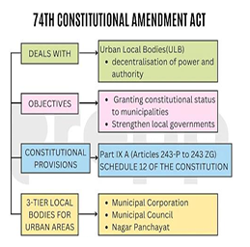
CONSTITUTIONAL AMENDMENT
Parliament enacted the Constitution (74th Amendment) Act, 1992 relating to municipalities in 1992. The Act received the assent of the President on 20th April 1993. The Government of India notified 1st June 1993 as the date from which the said Act came into force.

Slide 6
ASLB( Accounting Standard for Local Body
73rd and 74th Constitutional Amendment Acts ion 1992 &1993 empower PRIs and ULBs in areas like education, health, rural housing, and water supply etc
Definition of Local Body: Refers to local self-government entities at the third tier of governance, such as municipal corporations, municipalities, or panchayats.
Delegation of Functions: Local Bodies may delegate functions like building schools, roads, parks, etc., to other bodies, which may or may not be controlled by them, such as development authorities or parastatals.
28 States/Union Territories agreed to adopt double entry accounting under Urban Reforms Incentive Fund (URIF).
National Urban Renewal Mission mandates modern, accrual-based double entry accounting for Local Self Governments.
Proposed Second Generation Reforms under URIF-II aim to further promote accrual-based double entry accounting among Local Self Governments

Slide 7
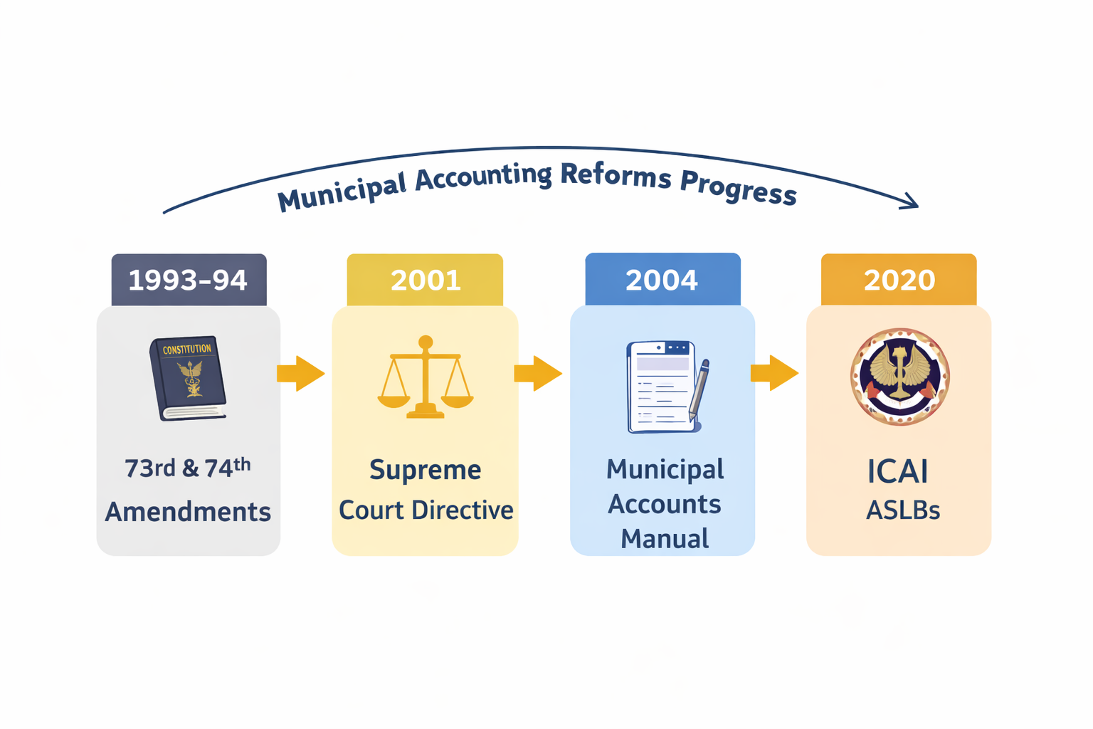
Journey of aslb
“This directive was a watershed moment. It moved municipal accounting away from single-entry cash systems toward accrual-based frameworks, laying the foundation for ICAI’s ASLBs.”

Slide 8
Accounting FRAMEWORK
IGAS: Cash‑basis disclosures, 4 mandatory standards.
IGFRS: Accrual‑basis reporting standards, still at draft/pilot stage.
ASLBs: Accrual‑basis standards for local bodies, aligned with IPSAS, voluntary but strongly recommended.
Together, they form a three‑tier framework:
IGAS → Current mandatory disclosures (cash basis).
IGFRS → Future accrual reporting for governments.
ASLBs → Accrual reporting for municipalities/local bodies.

Slide 9
IGAS
What is IGAS?
IGAS (Indian Government Accounting Standards) are standards issued to guide accounting and financial reporting of Government (Central & State).
They are developed by:
Government Accounting Standards Advisory Board (GASAB)
Under the Comptroller and Auditor General (CAG) of India
Thus standards applicable to the Central and State Governments are known as Indian Government Accounting Standards (IGAS). These are primarily designed for a cash-based system of accounting, though there is a gradual push toward accrual accounting

Slide 10
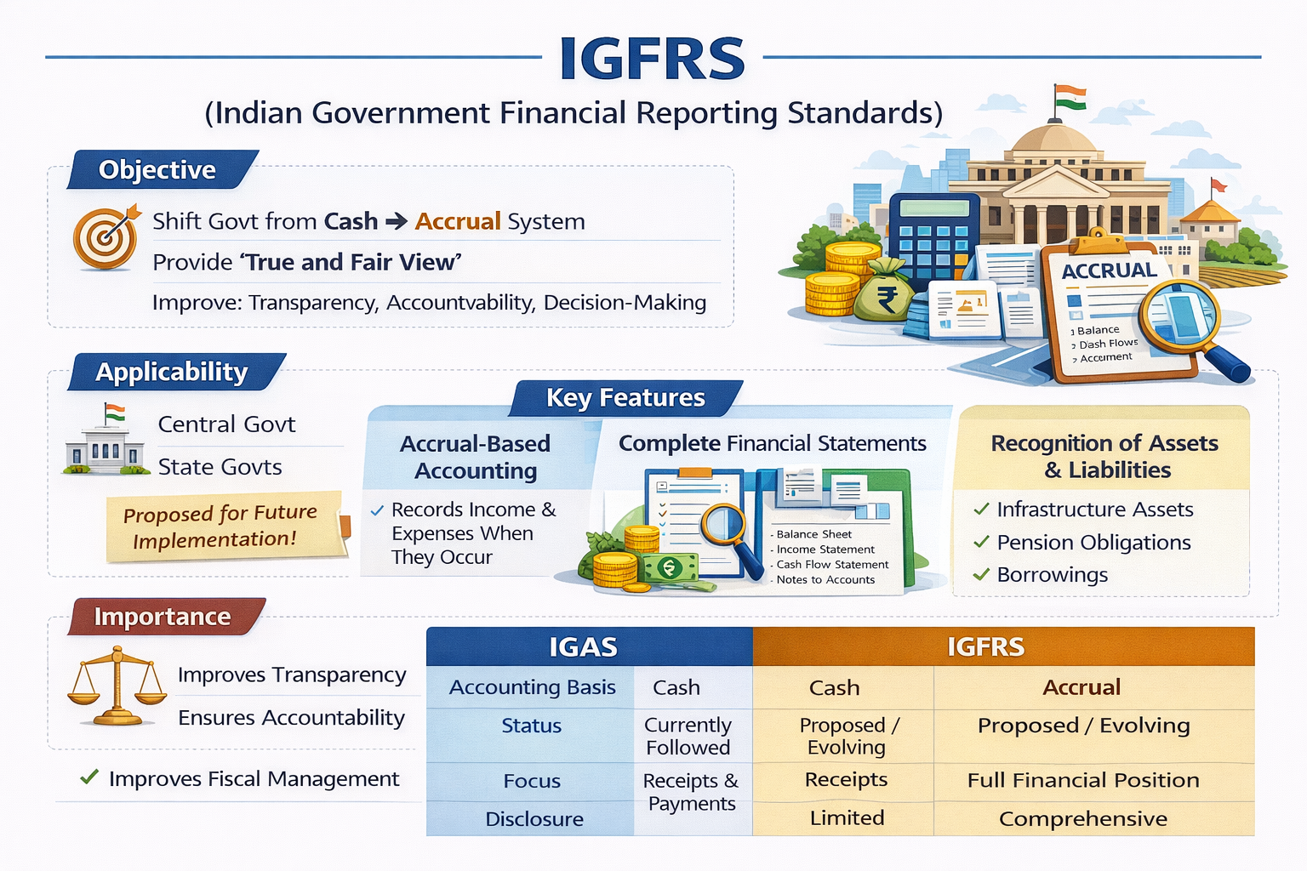
IGFRS:-

Slide 11
Indian government accounting standards-igas
IGAS No. | Title | Status (2026) | Mandatory Applicability
IGAS 1 | Guarantees Given by Governments: Disclosure Requirements | Notified by GoI | ✅ Mandatory
IGAS 2 | Accounting and Classification of Grants‑in‑Aid | Notified by GoI | ✅ Mandatory
IGAS 3 | Loans and Advances Made by Governments | Notified by GoI | ✅ Mandatory
IGAS 4 | Prior Period Adjustments | Notified by GoI | ✅ Mandatory

Slide 12
Indian government accounting standards-igas
IGAS No. | Title | Status (2026) | Mandatory Applicability
IGAS 5 | Government Investments in Equity | Approved by GASAB – Under consideration of GoI | ❌ Not yet mandatory
IGAS 6 | Accounting for Fixed Assets of Government | Guidance Note stage – Under review | ❌ Not yet mandatory
IGAS 7 | Provisions, Contingent Liabilities and Contingent Assets | Draft under review | ❌ Not yet mandatory
IGAS 8 | Accounting for Inventory and Consumables | Draft under review | ❌ Not yet mandatory

Slide 13
Igas-igfrs-aslb
Aspect | IGAS | IGFRS | ASLBs
Full Form | Indian Government Accounting Standards | Indian Government Financial Reporting Standards | Accounting Standards for Local Bodies
Issuing Authority | GASAB (Government Accounting Standards Advisory Board) under C&AG | GASAB under C&AG | ICAI (Committee on Public & Government Financial Management)

Slide 14
Igas-igfrs-aslb
Applicability | Union & State Governments (cash basis) | Union & State Governments (transition to accrual basis) | Local Bodies (municipalities, panchayats, PRIs, ULBs)
Basis of Accounting | Cash basis (with enhanced disclosures) | Accrual basis (pilot stage, gradual adoption) | Accrual basis (aligned with IPSAS)
Objective | Standardize disclosures under cash system | Prepare for accrual accounting in government | Improve transparency & comparability in local body accounts

Slide 15
Igas-igfrs-aslb
Examples | IGAS 1 – Guarantees; IGAS 2 – Grants-in-Aid; IGAS 3 – Loans & Advances; IGAS 4 – Prior Period Adjustments | IGFRS 1 – Presentation of Financial Statements; IGFRS 2 – Revenue from Exchange Transactions; IGFRS 3 – Inventories | ASLB 1 – Presentation of Financial Statements; ASLB 23 – Revenue from Non-Exchange Transactions; ASLB 24 – Budget Information
Mandatory Status (2026) | 9 issued, 4 notified & mandatory | Draft stage, not yet mandatory | Voluntary adoption, recommended by ICAI; gradually being implemented

Slide 16
Reporting requirements and need of standards
The increasing reporting requirements, due to Finance Commission recommendations, Ministry requirements, Grants utilization conditions, uploading of results in prescribed manner, format and time frame has created need for Standards.
Like Untied Grant (40%) / Tied Grant (60%) will be released in two instalment by the Union Government after receipt of Grant Transfer Certificate.
The eligible conditions include
  preparing proper accounts and audit of financial statement,
  Uploading of information/data in eGramSwaraj containing desired details
  Uploading of details about utilization 15" F.C. funds etc.

Slide 17
Purpose of Government Accounting
Accountability to Public.
Budgetary Control.
Transparency
Facilitates Audit
Legal & Regulatory Compliance
Decision Making & Policy Formulation
Efficient Resources Management
Financial Reporting

Slide 18
Conceptual pillars of accounting
Cash vs. Accrual Accounting: Traditionally, Indian government accounting is cash-based. The academic debate focuses on the transition to Accrual-Based Government Accounting (ABGA) to improve transparency.
Role of Article 150: The Constitution of India (Article 150) mandates that the accounts of the Union and States shall be kept in such form as the President may, on the advice of the C&AG, prescribe.
GASAB’s Roadmap: Study the "Concept Paper on Transition to Accrual Accounting" published by GASAB, which serves as a foundational academic text for modernizing Indian government accounts.

Slide 19
Profit vs public accountability
Profit vs Public accountability
Basis | Profit Accountability | Public Accountability
Objective | Maximization of profit | Welfare of public & service delivery
Primary Users | Shareholders, investors | Parliament, citizens, CAG
Focus | Revenue, expenses, profit | Budget, expenditure control, compliance
Nature of Entity | Private sector companies | Government & public sector
Measurement | Profit/Loss, EPS, ROI | Budget vs Actual, fund utilization
Accountability To | Owners/Investors | Public / Legislature
Decision Criteria | Profitability & efficiency | Social benefit & policy outcomes
Financial Statements | P&L, Balance Sheet, Cash Flow | Finance Accounts, Appropriation Accounts
Audit Objective | True & fair view of profit | Compliance + propriety + performance
Risk of Failure | Losses, insolvency | Misuse of public funds, governance failure

Slide 20
Cash Basis
Recognize on receipt/payment
🏛️ In Government Context:-
Traditionally followed by Central & State Governments
Forms the basis for:
  Receipts and Payments Account
  Appropriation Accounts
  Finance Accounts (primarily cash-based)

Slide 21
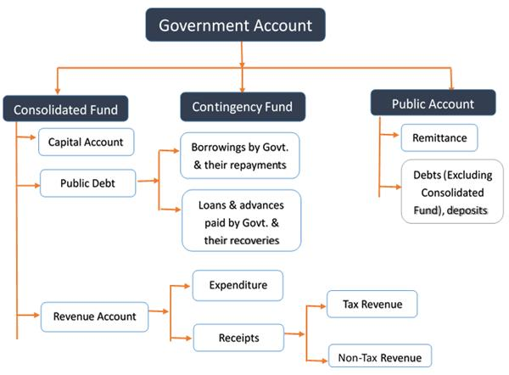
Types of Accounts
Consolidated, Contingency, Public

Slide 22
Budgetary Accounting
Allocation vs actual
Budget Allocation: Amount approved by Parliament/Legislature.
Actual: Amount actually received/spent during the Financial Year.
Basis | Budget Allocation | Actual
Nature | Estimated / Planned | Real / Executed
Approval | Authorized by Legislature | No approval needed (already within budget)
Timing | Before financial year | During/after financial year
Purpose | Planning & control | Performance evaluation
Flexibility | Fixed (subject to revision) | May vary (over/under spending)

Slide 23
Limitations
No accruals, no full picture
Cash Basis Limitation
Inadequate Disclosure
No Cost Accounting System
Time Lag in Reporting

Slide 24
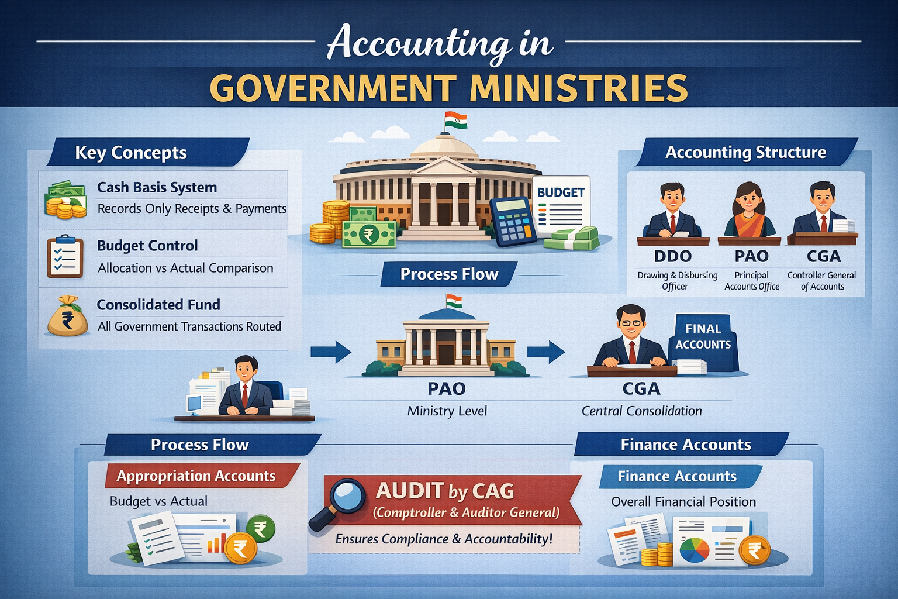
Ministries
Cash system

Slide 25
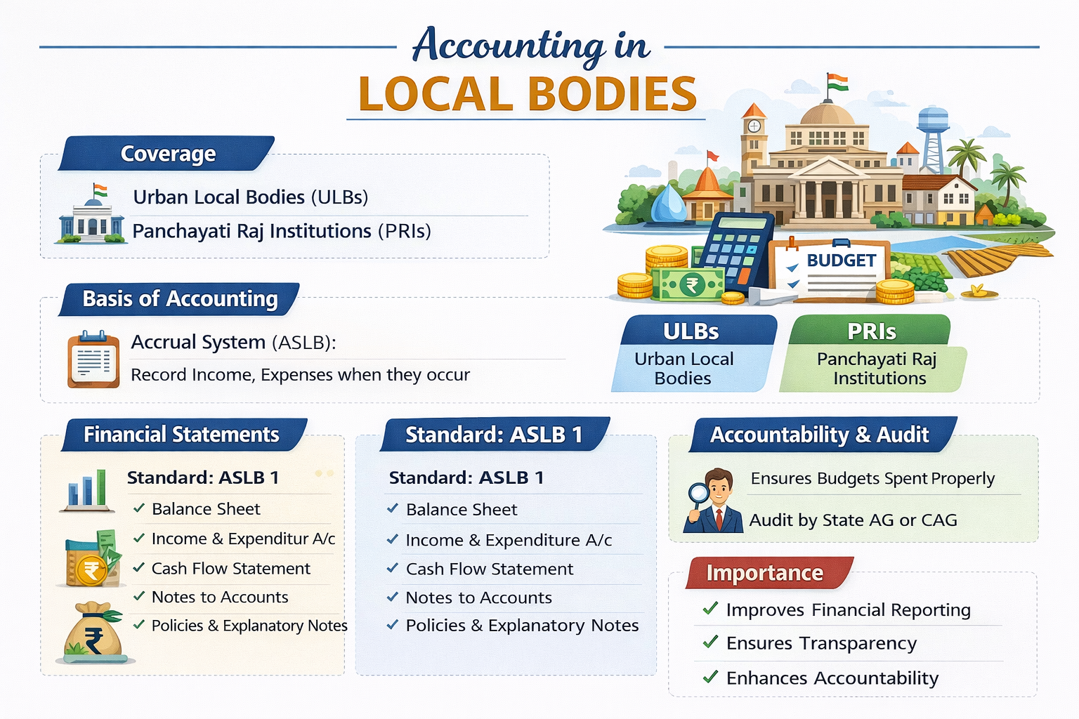
Local Bodies
Gradual accrual

Slide 26
Accounting standards for local bodies (ASLB)
NOW LET US MOVE TO ASLB
ASLB 1 Presentation of Financial Statements
ASLB 2 Cash Flow Statements
ASLB 3 Accounting Policies, Change in Accounting Estimates & Errors
ASLB 4 The Effects of Changes in Foreign Exchange Rates
ASLB 5 Borrowing Costs
ASLB 9 Revenue from Exchange Transactions
ASLB 11 Construction Contracts
ASLB 12 Inventories
ASLB 13 Leases
ASLB 14 Events after the Reporting Date
ASLB 16 Investment Property

Slide 27
Accounting standards for local bodies (ASLB)-Contd..
ASLB 17 Property, Plant and Equipment
ASLB 18 Segment Reporting
ASLB 19 Provisions, Contingent Liabilities and Contingent Assets
ASLB 20 Related Parties Disclosure
ASLB 21 Impairment of Non-Cash-Generating Assets
ASLB 23 Revenue from Non-Exchange Transactions (Taxes and Transfers)
ASLB 24 Presentation of Budget Information in Financial Statements
ASLB 26 Impairment of Cash-Generating Assets
ASLB 31 Intangible Assets
ASLB 32 Service Concession Arrangements: Grantor

Slide 28
Accounting standards for local bodies (ASLB)-Contd..
ASLB 33 FirstTime Adoption of Accrual Basis Accounting Standards for Local Bodies (ASLBs)
ASLB 34 Separate Financial Statements
ASLB 36 Investments in Associates and Joint Ventures
ASLB 39 Employee Benefits
ASLB 42 Social Benefits

Slide 29

discussion of some aslb(s)

Slide 30
Overview
Introduction to Accounting Standards for Local Bodies (ASLB):
  ASLB are a set of AS issued by the Institute of Chartered Accountants of India (ICAI) specifically for local bodies such as municipal corporations, municipalities, and PRIs.
  Its aim to improve the quality, consistency, and transparency of financial reporting by local bodies.
Applicability of ASLB:
  ASLB are applicable to all local bodies in India that are required to prepare FS in accordance with the provisions of the Constitution of India and relevant state laws.
  ASLB prescribe guidelines for the preparation and presentation of financial statements, including balance sheets, income expenditure statements, and cash flow statements.
  They also cover accounting policies, revenue recognition, expenditure classification, and financial disclosures.
Benefits of ASLB in Local Bodies:
  ASLB improve the transparency and reliability leads better decision-making by stakeholders.
  They facilitate comparability of financial statements across different local bodies, enabling benchmarking and performance evaluation.

Slide 31
Overview -2
Challenges in Implementing ASLB:
  Limited awareness and understanding of ASLB among LB Staff and accountants.
  Lack of capacity and resources to implement ASLB effectively, especially in smaller LB.
Role of Transparency in Financial Reporting:
  Transparency in financial reporting involves providing clear, accurate, and timely information about the financial performance and position of an organization.
  It enhances accountability and helps in identifying and addressing financial irregularities or mismanagement.
Initiatives to Improve Transparency:
  The Government of India has introduced various initiatives to improve transparency in financial reporting by local bodies, such as mandatory audits by the Comptroller and Auditor General (CAG).
  Training programs and capacity-building efforts are also being undertaken to enhance the understanding and implementation of ASLB.

Slide 32
ASLB 1
Objective: The objective of this Standard is to ensure comparability of general purpose financial statements both within the entity’s financial statements of previous periods and with the financial statements of other entities.
Guidance and Requirements: It sets out overall considerations, guidance for structure, and minimum content requirements for financial statements prepared under accrual basis accounting.
Recognition, Measurement, and Disclosure: Specific transactions and events are addressed in other Accounting Standards for Local Bodies (ASLBs).
Applicability: This Standard applies to all general purpose financial statements prepared under accrual basis accounting in accordance with ASLBs.
Differences from AS 1: ASLB 1 focuses on the presentation of financial statements, unlike the existing AS 1 (issued 1979), which primarily deals with the disclosure of accounting policies. ASLB 1 has a wider scope, making a line-by-line comparison with existing AS 1 impractical.

Slide 33
ASLB 1
OBJECTIVE:-
To prescribe the basis for presentation of general-purpose financial statements
Ensure comparability
Over time (same entity)
Across entities (different local bodies)
Components of Financial Statement
Balance Sheet
Income & Expenditure Statement
Cash Flow Statement
Notes to Accounts
Accounting Policies & Explanatory Notes

Slide 34
ASLB 3
Objective:The objective of ASLB 3 is to establish criteria for selecting and changing accounting policies, as well as outlining the accounting treatment and disclosure of changes in policies, estimates, and error corrections.
Requirements : ASLB 3 aims to improve the relevance, reliability, and comparability of an entity's financial statements over time and with those of other entities.
Compaarision :In contrast, the objective of existing AS 5 is to regulate the classification and disclosure of specific items in the statement of profit and loss, ensuring uniformity in the preparation and presentation of financial statements.

Slide 35
ASLB 23- Revenue from Non-Exchange Transactions (Taxes and Transfers)
Revenue from Non-Exchange Transaction
This Standard addresses revenue arising from non-exchange transactions. Revenue arising from exchange transactions is addressed in ASLB 9, “Revenue from Exchange Transactions‟. While revenues received by local bodies arise from both exchange and nonexchange transactions, the majority of revenue of local bodies is typically derived from non-exchange transactions such as: (a) Taxes; and (b) Transfers (whether cash or non-cash), including grants, debt forgiveness, fines, gifts, donations, and goods and services in-kind.
An entity that prepares and presents financial statements under the accrual basis of accounting should apply this Standard in accounting for revenue from non-exchange transactions.
This Standard does not apply to an entity combination that is a nonexchange transaction.

Slide 36
ASLB 23
Objective
To prescribe when and how revenue should be recognized
Ensure proper accounting of taxes and government transfers
Improve transparency and comparability

Slide 37
ASLB 23
Types of Non-Exchange Revenue
1. Taxes
Property tax
Professional tax
Entertainment tax
2. Transfers
Government grants
Donations
Aids and subsidies

Slide 38
ASLB 24
PRESENTATION
OF
‘BUDGET INFORMATION’

Slide 39
ASLB 24
Objective
To ensure transparency in budget execution
Enable comparison of:
  Budget (planned) vs
  Actual (achieved)
Improve accountability to legislature and public

Slide 40
ASLB – 33 First-Time Adoption of Accrual Basis Accounting Standards for Local Bodies
The objective of this standard is to guide first-time adopters transitioning to accrual basis ASLBs in presenting high-quality financial information.
It aims to ensure transparent reporting of the transition process, establish a suitable starting point for accrual basis accounting, and ensure that benefits outweigh costs.
Entities should apply this standard when preparing annual financial statements upon adoption of, and during the transition to, accrual basis ASLBs.
This standard applies to all entities categorized as Local Bodies according to the 'Preface to the Accounting Standards for Local Bodies.'

Slide 41
Aslb 42 Social Benefits
Objective: Guide first-time adopters transitioning to accrual basis ASLBs.
Ensure transparent reporting of transition, establish suitable starting point for accrual basis accounting.
Apply standard during preparation of annual financial statements upon adoption of, and during transition to, accrual basis ASLBs.
Applicable to all entities categorized as Local Bodies according to 'Preface to the Accounting Standards for Local Bodies'.
To accomplish that, this ASLB establishes principles and requirements for:
Recognizing expenses and liabilities for social benefits;
Measuring expenses and liabilities for social benefits;
Presenting information about social benefits in the financial statements; and
Determining what information to disclose to enable users of the financial statements to evaluate the nature and financial effects of the social benefits provided by the reporting entity.

Slide 42
Local bodies- budget
The Importance of the Approved Budget:
Local bodies typically prepare budgets, which are made publicly available as required by relevant legislation.
Legislation often defines the contents of budget documentation.
Elected representatives, comprising the governing body, oversee and hold management financially accountable through the budget and other mechanisms.
The approved budget often serves as the basis for setting taxation levels and obtaining approval for spending from the governing body.
The Regulatory Role of Local Bodies:
Local bodies prepare budgets, publicly available per legislation.
Legislation defines budget documentation contents.
Elected representatives oversee and hold management financially accountable.
Approved budget sets taxation levels and obtains spending approval.

Slide 43
Gov vs PSU
Different treatment
Basis | Government Accounting | PSU Accounting (Govt Companies)
Objective | Public welfare & accountability | Profit + commercial efficiency
Accounting Basis | Cash Basis (primarily) | Accrual Basis
Applicable Standards | ASLB / Govt Rules / CAG | AS / Ind AS (ICAI + Companies Act)
Governing Law | Constitution, GFR, Govt Accounting Rules | Companies Act, 2013
Financial Statements | Finance A/c, Appropriation A/c | P&L, Balance Sheet, Cash Flow
Budgeting | Very important (core feature) | Limited role (internal planning)
Revenue Recognition | On cash basis | On accrual basis
Audit Authority | CAG (Comptroller & Auditor General) | Statutory Auditor + CAG supplementary audit
Focus | Budget vs Actual | Profit, EPS, ROI
Users | Parliament, Public | Investors, Govt, Stakeholders

Slide 44
AUDIT PERSPECTIVE
Compliance with Laws & Regulations
Budgetary Control & Appropriation Audit
Cash-Based Accounting Verification
Internal Controls & Financial Discipline
Propriety Audit (Public Interest Test)
Performance / Efficiency Audit
Classification & Accounting Accuracy
Fraud, Corruption & Vigilance Angle
Grants, Subsidies & Scheme Audit
Reporting & Accountability

Slide 45
Reference(s)
GASAB Official Website: gasab.gov.in (Best for IGAS texts and Notification status).
C&AG of India: Look for "Government Accounting" reports and the Audit & Accounts Regulations.
ICAI Knowledge Portal: Search for "Accounting Standards for Local Bodies" for specific ASLB guidance notes.
Ministry of Finance: Look for the Government Accounting Rules (1990) and General Financial Rules (GFR).

Slide 46



Contact for more details : cpf.aslb@icai.in
Follow ICAI on Social Media - http://www.icai.org/followus

