Slide 1

Capital Protection before wealth creation
Presented by: CA Sachin Saluja

Slide 2

Disclaimer
I am not a SEBI Registered Investment Advisor. This session is purely for educational and awareness purposes and should not be considered as investment advice, stock recommendation, or a solicitation to buy/sell any securities. Participants are advised to consult their financial advisor and consider their risk profile before making any investment decisions. The examples shared are only for illustration and may not be suitable for everyone. I / We shall not be responsible for any financial loss or damage arising from actions taken based on this presentation.

Slide 3

Why this topic matters
Markets reward Discipline, not Intelligence.
Wealth is created by not Losing Big.
Professionals also fall into Behavioural Traps.
Objective : Help CAs protect Capital First, Grow Later.

Slide 4
Biggest myths in investing
❌ Long-term investing means never selling
✔️ Long-term means staying unless Fundamentals/Trend break
❌ Mutual Funds are always safe
✔️ They can also become exit routes
❌ Timing doesn’t matter (Eg: Market Cap to GDP Ratio Peaks)
✔️ Bad timing destroys compounding
❌ Quality Business = Safe Investment
✔️ Price & Valuation matter more (Paytm & Ola)

Slide 5
Common mistakes even smart investors do
Blind Faith in Narratives
Averaging Losers
No predefined Exit Plan
Overconfidence after few Gains
Different from Real Life
Emotional attachment to Stocks
IPO Frenzy

Slide 6
Don’t Become Promoters exit route
How Investors get Trapped
Promoters selling silently
Mutual funds providing liquidity
Retail buying “confidence-building” news
Checklist before Investing
Promoter Holding Trend
Pledging Status
Institutional ownership Behaviour
Sudden story selling in media

Slide 7
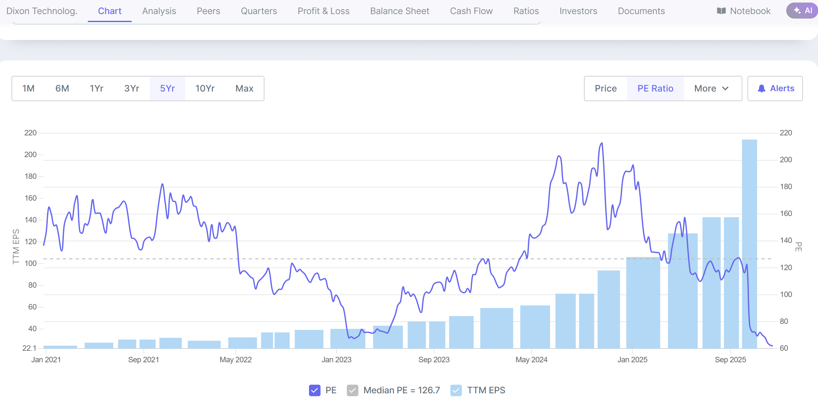

Slide 8
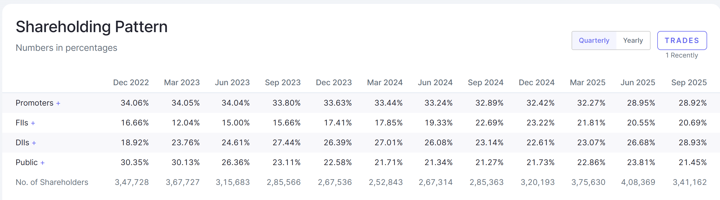
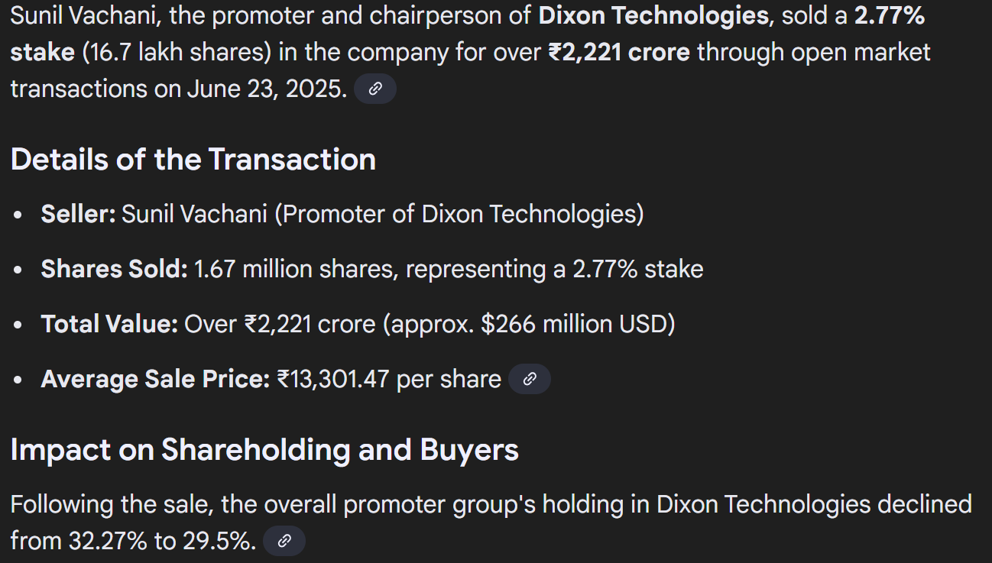

Slide 9

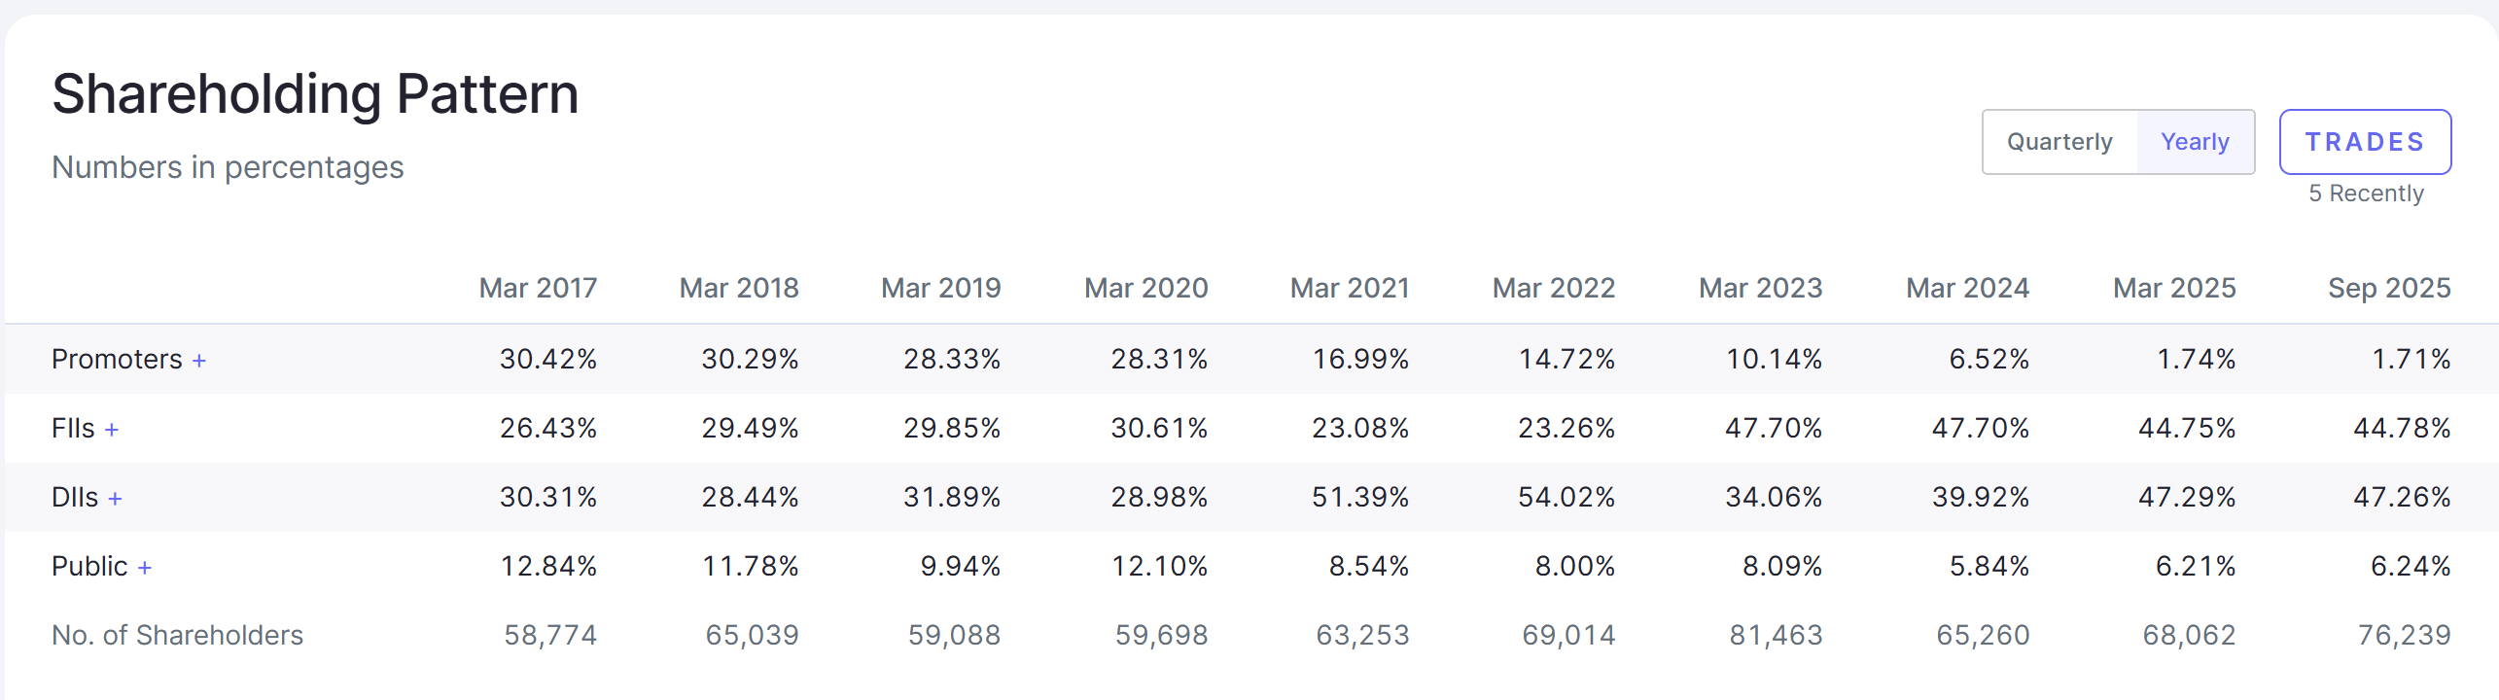
Case study 2 (mfsl)

Slide 10
Choosing the Right Mutual Fund / Stocks
Beyond Star Ratings
Fund Manager capability
Portfolio Quality
Whether Fund is used as Promoter Exit
Risk-adjusted consistency over returns
AUM size & Liquidity Discipline
Relative Strength

Slide 11
Real life vs capital markets
In real life you look for buying things at discount whereas in Stock Market if something is at discount it’s likely to get more cheaper and fall.
In Real Life if your Finger gets Trapped, you use your Hand to Save the Finger, whereas if your Finger gets trapped in Stock Market, you cut the Finger.
In real Life you never board a Running Train, but in Stock Market you have to Board a Running Train.
In Stock Market when I win, my height gets increased due to Euphoria and Position Sizing.

Slide 12
Avoiding Smart Money Traps
Media-driven optimism
Influencer-led Hype
Late-stage entry in momentum
Operator-driven stocks
Corporate Governance blind spots
Always use Stop Loss

Slide 13
Key Takeaways
Protecting Capital is the First Profit
Myths destroy wealth
Discipline beats Intelligence
Trend + Risk Management = Survival
Smart Investing is Smart Exiting

Slide 14

CA Sachin Saluja
sachin@finnov8.in
Contact : 9818-203-123

