Slide 1

Changing landscape of LABOUR LAWS in INDIA
An Opportunity
For Professionals

Slide 2

Let us understand few Important figures
146
Crore
India’s Population
99-100
Crores
Working Population
52
Crores
Total # of
workers
10-20%
Organized
Sector
Unorganized
Sector
80-90%
200
Central Labour Laws
State Labour
Laws
400,000+
Labour Law
Cases pending
52

Slide 3
Labour codes – an overview
Consolidate numerous codes
Uniformity in definitions
Code on Wages
Use of technology
Transparency and accountability
Code on Occupational Safety, Health and working conditions
Code on Industrial Relations
New codes
Effective enforcement
Ease of implementation
Code on Social Security
3

Slide 4
Overview of the codes

Slide 5

Legislations subsumed
The code on wages 2019
The Payment of Wages Act, 1936;
The Minimum Wages Act, 1948;
The Payment of Bonus Act, 1965; and
The Equal Remuneration Act, 1976
The code on Social Security 2020
The Employee Compensation Act ,1923;
The Employees' State Insurance Act, 1948;
The Employees' Provident Funds and Miscellaneous Provisions Act, 1952;
The Employment Exchanges (Compulsory Notification of Vacancies) Act, 1959;
The Maternity Benefit Act, 1961;
The Payment of Gratuity Act, 1972;
The Cine-Workers Welfare Fund Act, 1981;
The Building and Other Construction Workers' Welfare Cess Act, 1996;
The Unorganised Workers' Social Security Act, 2008

Slide 6


Legislations subsumed (cont’d)
The industrial relations code 2020
The Trade Unions Act, 1926,
The Industrial Employment (Standing Orders) Act, 1946 and
The Industrial Disputes Act, 1947
The occupational safety, health and working conditions code 2020
The Factories Act, 1948;
The Mines Act, 1952;
The Dock Workers (Safety, Health and Welfare) Act, 1986;
The Building and Other Construction Workers (Regulation of Employment and Conditions of Service) Act, 1996;
The Plantations Labour Act, 1951;
The Contract Labour (Regulation and Abolition) Act, 1970;
The Inter-state migrant workmen (Regulation of Employment and Conditions of Service) Act, 1979;
The Working Journalist and other News Paper Employees (Conditions of Service and Misc. Provision) Act, 1955;
The Working Journalist (Fixation of rates of Wages) Act, 1958;
The Motor Transport Workers Act, 1961;
Sales Promotion Employees (Condition of Service) Act, 1976;
The Beedi and Cigar Workers (Condition of Employment) Act, 1966;
The Cine Workers and Cinema Theatre Workers Act 1981

Slide 7
Definitions and their impact

Slide 8
Code on Wages / Code on Social Security
Definition of wages
Meaning and inclusions
Means all remuneration whether by way of salaries, allowances or otherwise, expressed in terms of money or capable of being so expressed which would, in terms of employment, express or implied, where fulfilled, be payable to a person employed in respect of his employment, and includes – Basic pay; Dearness allowance; and Retaining allowance, if any.
Specified exclusions
Conditional inclusions
Value of remuneration in kind
Statutory bonus payable but not forming part of remuneration;
Value of house accommodation and utilities
(such as light, water, medical attendance, etc.);
Employer contribution to provident fund / pension together with accretions;
Conveyance allowance or value of travelling concession;
Sum paid to defray special expenses due to
nature of work;
House rent allowance;
Remuneration payable under any award settlement;
Any overtime allowance;
Any commission payable;
Any gratuity payable on termination;
Any retrenchment comp/ benefit payable or ex gratia payment made
Where the aggregate of specified exclusions as highlighted:
exceeds one-half or such other notified percentage of all remuneration calculated under this clause,
amount which exceeds such one-half
or other percent, so notified
shall be deemed as remuneration
& shall accordingly be added under this clause
Conveyance/value of travel concession, house rent allowance, remuneration payable under award or settlement and overtime allowance shall be taken for computation of wage – for the purpose of equal wages to all genders
Where an employee is given remuneration in kind
in lieu of either the whole or part of the wages payable to him
value of such remuneration as does not exceed 15% of total wages payable to him
Shall be deemed to form part of wages of such employee.

Slide 9
Code on Social Security
Key definitions and implications
Employer
Means a person who employs directly or through any person or on behalf of any person one or more employees in his establishment
Includes a Contractor and legal representative of the deceased employer.
Employee
*exclusion specified
Any person (other than an apprentice) employed on wages by the establishment to do any skilled, semi-skilled, unskilled, manual, operational, supervisory, managerial, administrative, technical or clerical work for hire or reward, whether the terms of employment be express or implied
and also includes a person declared to be an employee by the appropriate government
In relation to an establishment means a person, who—
(i) undertakes to produce a given result for the establishment, other than a mere supply of goods or articles of manufacture to such
Contractor
establishment through contract labour; or
(ii) supplies contract labour for any work of the establishment as mere human resource and includes a sub-contractor;

Slide 10
Code on Social Security
Key definitions and implications
Gig worker
Means a person who performs work or participates in a work arrangement and earns from such activities outside of traditional employer-
employee relationship.
Fixed term
employment
Means the engagement of an employee on the basis of a written contract of employment for a fixed period
Platform work
Means a form of employment in which organizations or individuals use an online platform to access other organizations or individuals to solve
specific problems or to provide specific services in exchange for payment.
Means a home based worker, self-employed worker or a wage worker in the unorganized sector and includes a worker in the organized sector who is not covered by the Industrial Disputes Act, 1947 or Chapters relating to Provident fund, State Insurance, Gratuity, Maternity Benefit and
Unorganized worker
Compensation under this Code.

Slide 11
Code on wages and code on social security Salient features
Particulars
Code on wages
Applies to all establishments, employees and employers as defined unless specifically exempt in the code
Covers all employees including managerial cadre
Wage definition standardized
State government minimum wage rates to be aligned to national floor wages
Need to meet wages payment dates as prescribed
Recoveries from wages specified with monthly recovery capped at 50%
Settlement time of dues in case of resignation/dismissal shortened
Time for preferring claims extended
Role of inspector widened to include facilitation function
Penalties and prosecution enhanced
Code on social security
Coverage broadened to include gig/platform workers, fixed term employees, and those in the unorganized sectors with the organized sector
Period of limitation introduced
No specific reference to international workers
Stringent penalties and prosecution provisions provided for
A contractor is identified as an “employer” having independent responsibilities – compliance responsibility from the principal employer reduced

Slide 12
Code on wages and code on social security Areas of impact
Areas of impact | Key change triggering the impact | Challenges to be addressed
Definition of wages | Uniform and wider definition of wages as compared to varied definitions under existing regulations | Change in coverage of employees for ESI, Payment of Bonus Act etc. Impact on PF and gratuity contributions
Provident Fund (PF) | Change in definition of wages | Increase in quantum of PF contributions for domestic employees drawing salary below wage ceiling (presently INR 15,000) and international workers Review of employment contracts and policies relating to employees earning more than INR 15,000 pm
Gratuity | Change in definition of wages Extending gratuity benefits to fixed term employees | Likely increase in the quantum of gratuity – new inclusions in the definition - retroactive impact? Individuals on fixed term employment entitled to gratuity benefits under the code on a pro-rata basis in addition to regular eligible employees
Overtime | Employee covered under the schedule employment alone are eligible for overtime | Employees in supervisory and managerial role also entitled for overtime wages
Gig workers/platform workers | Presently, there is no specific social security schemes for the gig/platform workers | Government to introduce a scheme enabling such employees to be eligible for social security benefits Aggregators will be required to contribute towards such scheme
Payment of wages | Max deduction upto 50% of total wages | Impact on settlement timelines, capping of deductions from wages etc.

Slide 13
Industrial relations code and occupational safety, health and working conditions code Salient features
Particulars
Industrial relations code |  | Limit of worker enhanced from 100 to 300 for applicability of standing order; Constitution of works committee, if 100 or more workers are employed and ordered by appropriate government; Grievance redressal committee to complete its proceedings within 30 days of receipt of application; Prohibits employers, workers, and trade unions from committing any unfair labour practices such as restricting workers from forming; trade unions, coercing workers to join trade unions, threatening worker, establishing employer sponsored trade union, etc. Increase in retrenchment cost- additional compensation towards re-skilling fund, retrenchment compensation; Preference to retrenched worker for re-employment within 1 year; Notice of strike, lockout-extended to all industries; Additional ground for strike - mass leave; Prior approval of government - layoff, retrenchment, closure where 300 or more workers (factory, mine, plantation); Introduction of concept of negotiating union
The occupational safety, health and working conditions code |  | Single registration for all establishments; Working hours: 8 hours with a spread of 48 hours in a week; Issuance of appointment letter to employees/workers is mandatory; Prohibition to engage contract labour in core activities; Mandatory free health check-ups for below categories: Who has attained age of 45 years for prescribed industries (factory, mine, plantation); or Worker who are engaged in hazardous process/mines List of benefits for inter-state migrant workers has been extended; Flexibility in employment of women; Constitution of safety committee and appointment of safety officer in prescribed industries; Constitution of national occupational safety and health advisory board for monitoring the implementation of the code;
 | Enhancement of monetary penalties and introduction of compounding/composition

Slide 14
Industrial relations code and code on occupational safety, health and working conditions code Impact areas
Areas of impact | Key change triggering the impact | Challenges to be addressed
Core activity | Introduction of concept of core activity | Contract labour is prohibited to engage in core activities subject to certain exemptions The normal functioning of the establishment is such that the activity is ordinarily done through contractor; or The activities are such that they do not require full time workers for the major portion of the working hours in a day or for longer periods, as the case may be; Any sudden increase of volume of work in the core activity which needs to be accomplished in a specified time
Mandatory issuance of appointment letter | Employee covered under existing act are sale promotion employees | Appointment letter to be issued to every employee in specified format with mandatory details: Aadhar number Labour Identification Number (LIN) of the establishment Universal Account Number (UAN)/Insurance Number (ESIC), applicability of social security EPFO and ESIC benefits Appointment letter in specified format shall be issued to existing employees within 3 months of commencement of code
Leave encashment | Reduction in time limit to be eligible for leave with wages Leave can be demanded for encashment while in service | Worker who has worked for 180 days or more in a calendar year will be entitled for leave with wages Worker shall be entitled on his demand for encashment of leave at the end of calendar year Where the leaves exceeds 30 days, worker shall be entitled to encash the exceeded leaves
Re-skilling fund | Introduction of new concept of re-skilling fund | Overall increase in worker’s retrenchment compensation In addition to existing retrenchment compensation, 15 days wages to be contributed to re-skilling fund maintained with government: within 10 days of retrenchment
Negotiating union | Introduction of concept of negotiating union | It is mandatory on the employer to recognize negotiating union where the trade union is registered Going forward, negotiating union will negotiate on the terms of employment including consultation on standing orders

Slide 15
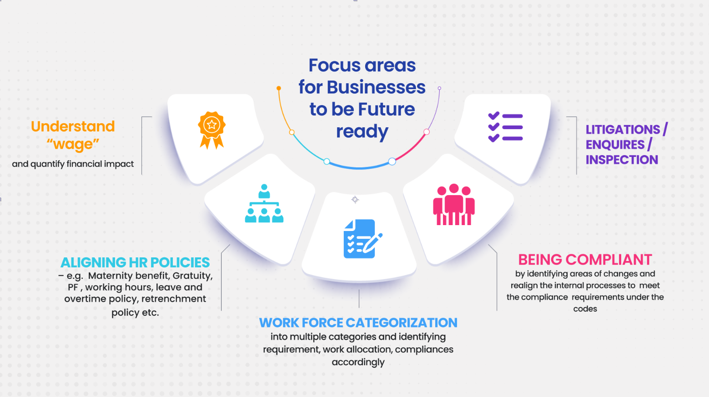
CA RUCHI GUPTA CONTACT: 8875000468

Slide 16
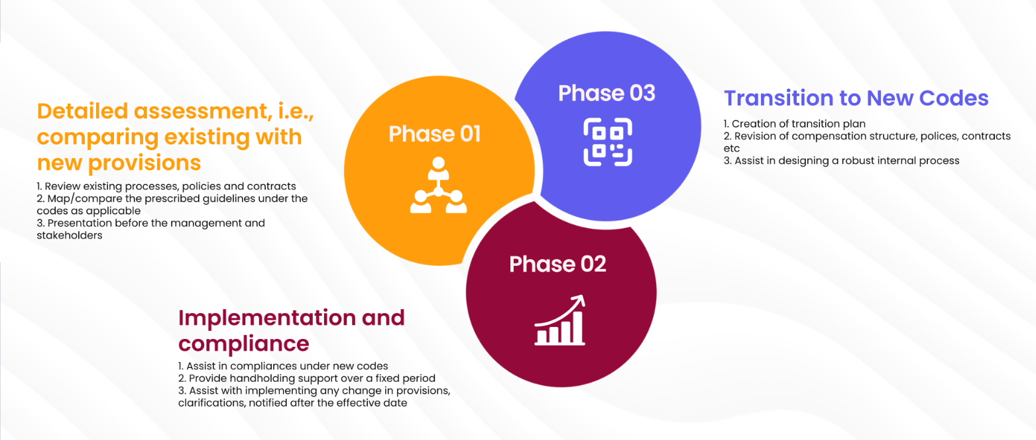
Transitioning to a new Legislative Framework is a journey.
You can support your client to Navigate this change in Legislation
CA RUCHI GUPTA CONTACT: 8875000468

Slide 17
Impact of change in “wage” definition case studies

Slide 18
Computation of wages
Impact of new wage definition
Example
Particulars | Amount (in INR per month)
Basic salary | 12,000
Uniform and Washing Allowance | 3,000
Statutory bonus | 3,000
House Rent Allowance | 3,000
Conveyance/ Travelling Allowance | 3,000
Special allowance | 6,000
Total | 30,000
Amount of Wages
Wages as per the current Minimum Wages Act (Basic + Special Allowance + HRA): INR 21,000
Wages as per the current Payment of Wages Act (Basic + Special Allowance + HRA): INR 21,000
Wages as per the current Payment of Bonus Act (Basic + DA + cash allowances): INR 27,000
Wages as per the current EPF Act (Basic (including special Allowance) + DA + retaining allowance + other allowances*): INR 24,000
Wages as per the current Payment of Gratuity Act (last drawn basic + DA): INR 12,000
Wages as per the current Maternity Benefit Act: (Basic + cash allowances + incentive bonus): INR 27,000
Wages as per the current ESIC Act: (Basic + cash allowances excluding bonus): INR 27,000
Wages as per the Code – INR 18,000 (Basic + Special Allowance)
*As per SC ruling on Vivekananda Vidyamandir & Ors.
CA RUCHI GUPTA CONTACT: 8875000468

Slide 19
Code on Social Security
Impact of the new employee definition – Illustration
Pay Components |  | Existing Laws (INR per month) | Social Security Code (INR per month)
Basic Wages | A | 14,000 | 14,000
House Rent Allowance | B | 6,000 | 6,000
Conveyance Allowance | C | 6,000 | 6,000
Special allowance | D | 4,000 | 4,000
Wages to be considered for EPF purposes |  | 24,000* (A+C+D) *contributions can be restricted to INR 15,000 | 18,000^ (A+D) ^If wage ceiling notified by the Central Government for the chapters on EPF & ESIC are same as the current ceiling (of INR 15,000 & INR 21,000 respectively), then such a person may not be regarded as an employee for EPF purpose but may get covered for ESIC purposes as per employee definition under the social security code
Wages to be considered for ESIC purposes |  | 30,000** (A+B+C+D) **Employee would not be covered under the current ESIC provisions
CA RUCHI GUPTA CONTACT: 8875000468

Slide 20
The Code on Social Security
Impact of the new wage definition on Gratuity / Maternity benefit – Illustration
Pay Components |  | Existing Laws (INR) | Social Security Code(INR)
Cost To Company |  | 12,00,000 | 12,00,000
Basic Pay (40% of CTC) | A | 4,80,000 | 4,80,000
House Rent Allowance | B | 2,40,000 | 2,40,000
Leave Travel Concessions C |  | 1,00,000 | 1,00,000
Fuel reimbursement | D | 1,20,000 | 1,20,000
PF Contributions | E | 57,600 | 72,000
Statutory Bonus | F | 1,00,000 | 1,00,000
Special allowance | G | 1,02,400 | 88,000
Total wages to be considered for Gratuity |  | 4,80,000 | 5,68,000 +Adj for exclusion as per definition i.e. 32,000
Understanding the impact for an employee with 7 years of service
Monthly Wages |  | 4,80,000/12 | 50% of total remuneration i.e. 600,000/12
Monthly wages for gratuity purpose |  | 40,000 | 50,000
Formulae for gratuity |  | Last drawn pay / 26 * 15 * no of years of service | Last drawn pay / 26 * 15 * no of years of service
Total Gratuity Amount |  | 1,61,538 | 2,01,923
Total wages to be considered for Maternity Benefit |  | 12,00,000 or 1,00,000 p.m. | 6,00,000 or 50,000 p.m.
*It is assumed that last drawn salary and average salary for 12 months is same.
CA RUCHI GUPTA CONTACT: 8875000468

Slide 21

CA Ruchi Gupta
+91 8875000468 gupta_ruchi31@yahoo.co.in
THANK
YOU

