Slide 1



Valuation under Insolvency and Bankruptcy Code (IBC), 2016
The Institute of Chartered Accountants of India
October 4, 2025
Presented by:
CA. Gandharv Jain
Partner, Finvox Analytics

Slide 2
1
Section 1
Introduction

Slide 3
Introduction
Valuation under Insolvency and Bankruptcy Code, 2016
The Insolvency & Bankruptcy Code, 2016 is a comprehensive legislation for resolution of corporate insolvency in a time-bound manner as asset value erodes quickly in distress.
Valuation under IBC is the process of determining fair and liquidation values of a company under insolvency, as mandated by the Insolvency and Bankruptcy Code, 2016.
Valuation is Central to:
Estimation of Fair Value and
Liquidation Value
Aids Committee of Creditors (CoC) in decision-making.
Helps compare resolution plan vs liquidation outcome.
FAIR VALUE - [Reg. 2(1)(hb)
Estimated realizable value of the assets of the corporate debtor, if they were to be exchanged on the insolvency commencement date between a willing buyer and a willing seller in an arm’s length transaction, after proper marketing and where the parties had acted knowledgeably, prudently and without compulsion.
LIQUIDATION VALUE - Reg. 2(1)(k)
Estimated realizable value of the assets of the corporate debtor, if the corporate debtor were to be liquidated on the insolvency commencement date

Slide 4
Introduction
Legal and Regulatory Framework for Valuation under IBC
Insolvency and Bankruptcy Code, 2016
IBBI (CIRP)
Regulations, 2016
IBBI (Liquidation)
Regulations, 2016
Section 25(2)(d): Empowers RP to appoint accountants, legal professionals, and registered valuers for insolvency proceedings.
Section 35: Mandates liquidators to take control of assets, realize them, and determine their value.
Provides statutory basis for professional valuation, aiding asset maximization and stakeholder decision-making.
Provide procedural guidance for asset valuation during Corporate Insolvency Resolution Process (CIRP).
Regulation 27: RP must appoint at least two registered valuers to determine asset values.
Regulation 35: Prescribes methodology for fair and liquidation value, including physical verification and adherence to international valuation standards, ensuring accurate and defensible valuations.
Govern asset valuation and realization during liquidation.
Regulation 34: Requires a comprehensive asset memorandum by the liquidator.
Regulation 35: Allows appointment of registered valuers for sale of assets. Ensures orderly disposal, maximizes recoveries for creditors, and safeguards stakeholder interests.

Slide 5
Introduction
Appointment of Registered Valuers
During the Corporate Insolvency Resolution Process (CIRP), the Resolution Professional (RP) appoints two IBBI-registered valuers within 7 days of their appointment.
Valuers provide independent reports on Fair Value and Liquidation Value.
Valuers must have the required qualifications, maintain objectivity, and have no conflict of interest.
Key Purpose of Valuation Report:
Evaluating Resolution Plans
Helps creditors and CoC evaluate the fairness and feasibility of proposed plans.
Ensures maximization of value for all stakeholders.
Calculating Haircut Percentages
Quantifies the difference between debt owed and recoverable amount.
Guides CoC in approving/rejecting resolution plans.
Supporting Litigations
Serves as expert evidence in disputes over asset value or plan fairness.
Used in NCLT/NCLAT proceedings to defend the resolution process.

Slide 6
2
Section 2
Overview of Valuation

Slide 7
Overview of Valuation
Valuation Process – Key Steps
Steps of Valuation as prescribed by ICAI Valuation Standard
Define the valuation base, premise of the value and valuation date
Analyse the asset to be valued and collect the necessary information
Identify the adjustments to the financial and non-financial informationfor the valuation
Consider and apply appropriate valuation approaches and methods
Arrive at a value or a range of values
Identify the subsequent events, if any
Valuation report and documentation

Slide 8
Overview of Valuation
Valuation Process – Valuation Engagements
Key Elements of Engagement
Contents of Engagement Letter
Details of the client;
Details of any other user/s of the valuation report apart from the client, if any;
Details of the valuer;
Purpose of the valuation;
Identification of the subject matter of valuation;
Valuation date;
Basis and premise of valuation;
Responsibilities of the client and the valuer;
Confidentiality obligations of the client and the valuer;
Scope/ limitations;
Fees ;
Details of third party expert, if any, and their scope of work, scope limitations, and responsibilities.
Scope;
Responsibility;
Authority;
Confidentiality;
Limitations;
Reporting; and
Compliance with Indian Valuation Standards
The terms of the valuation assignment shall be documented in writing in an engagement letter
The valuation shall not be constituted as an audit or review in accordance with the auditing standards; accounting/ financial /commercial/ legal/ tax/ environmental due diligence or forensic/ investigation services; and shall not include verification or validation work.

Slide 9
Overview of Valuation
Valuation Process – Report and Documentation
Contents of Valuation Report
Purpose of the valuation and appointing authority;
Identity of the valuer and any other experts involved in the valuation;
Disclosure of the valuer’s interest or conflict, if any;
Date of appointment, valuation date and date of the valuation report;
Inspections and/or investigations undertaken;
Background information of the asset being valued;
Nature and sources of the information used or relied upon;
Procedures adopted in carrying out valuation and valuation standards followed;
Valuation methodology used;
Restrictions on use of the valuation report, if any;
Major factors that were taken into account during the valuation;
Conclusion; and
Caveats, limitation and disclaimers to the extent they explain or elucidate the limitations faced by valuer, which shall not be for the purpose of limiting his responsibility for the valuation report.

Slide 10
3
Section 3
Valuation Approaches and Business Valuation

Slide 11
Valuation Approaches and Business Valuation
Valuation Approaches and Methods – IVS 103
Objective
Scope
Application
To provide guidance on various valuation approaches/ methods that can be adopted while valuing an asset.
Defines the approaches and methods for valuation.
This Standard shall be applied in selecting the appropriate valuation approaches and methodologies in determining the value of an asset, liability or a business
except
where a valuer is required to adopt valuation bases that are prescribed by a statute or regulation.
This standard explain various valuation approaches and methodologies along with the likely situations in which the various methods could be applied.
It provides to select appropriate valuation approach(es) and method(s) depending on valuation bases and premises
It provides to use combination of methods and give weightages. A valuer shall consider the reasonableness of the range of values, when evaluating a value resulting from use of multiple valuation approaches/ methods.

Slide 12
Valuation Approaches and Business Valuation
ICAI Valuation Standard 301 – Business Valuation
Objective
Scope
Application
Provides help and support to business valuers - performing business valuation or business ownership interests valuation engagements.
Establishes uniform concepts, principles, practices and procedures for valuers performing valuation services.
This Standard provides a broad framework of generally accepted principles, theories and procedures.
This Standard describes the basic principles which govern the valuer’s professional responsibilities and which shall be complied with whenever an engagement to estimate value is carried out.
A valuer shall apply valuation approaches and valuation methods, as described in Indian Valuation Standard 103 Valuation Approaches and Methods, and also use his professional judgment which is an essential component of estimating value.
When valuing a business or business ownership interest, a valuer may express either an exact number or a range of values. There could be different benchmarks at which the estimate of value of an entity could be expressed by the Valuer i.e. Enterprise value, Equity value and Business Value.

Slide 13
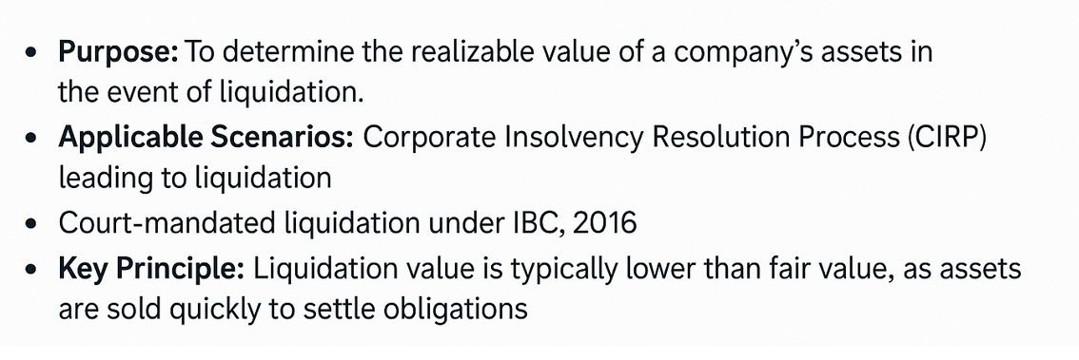
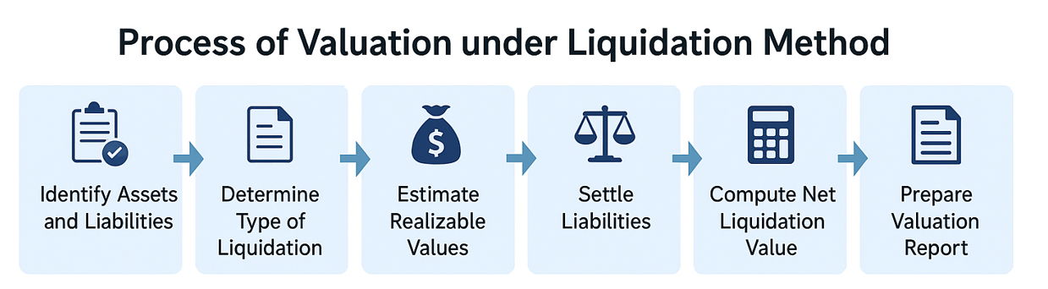
Valuation Approaches and Business Valuation
Liquidation Method

Slide 14
Valuation Approaches and Business Valuation
Approaches for Fair Value Method
Valuation Approaches
Market Approach
Income Approach
Cost Approach
Market Price Method
Discount Cash Flow Method
Earning Capitalization Method
Dividend Discount
Model
Intangible Asset Valuation -
Relief from Royalty Method
Multi Period Excess Earning Method
With or Without Method
Option Pricing
Models
Comparable Companies Multiple Method
Comparable Transaction Multiple Method
Reproduction Cost Method
Replacement Cost Method

Slide 15
Valuation Approaches and Business Valuation
Positives/ Limitations of Valuation Methods
Market based methods
Income based methods
Asset based methods
Positives
Realistic valuations as benchmarked to current valuations.
Relatively simpler compared to DCF
Flexible – can use different valuation multiples in different cases
Less impacted by valuer bias
Limitation
Very volatile
Markets may not necessarily value companies fairly at all points of time .
Adequate and reliable details for transaction multiples not available in most of the cases
Positives
Theoretically correct
Forward looking
Incorporates risk and time value of money
Focuses on cash returns
Limitation
Limited applicability in service industries/ new companies
Volume and complexity of assumptions
Adequacy of data
Extremely sensitive to small changes in assumptions
Positives
Easy to compute
Relatively stable
Limitation
Fail to factor the value of intangible assets like brands, technical know- how, distribution network etc
Impacted by accounting
Assumes assets always have ‘profit generating’ value
Ignores Returns vs. Cost of capital
“Realistic method in a number of situation”
“Develops a better understanding of the business”
“Generally not suitable for going concerns”

Slide 16
Valuation Approaches and Business Valuation
Fair Value vs. Liquidation Value (The IBC Imperative)
Asset | Book Value (₹ Cr) | Fair Value (₹ Cr) | Liquidation Value (₹ Cr)
Plant & Machinery | 50.0 | 30.0 (60%) | 17.5 (35%)
Inventory | 20.0 | 16.0 (80%) | 10.0 (50%)
Trade Receivables | 15.0 | 10.5 (70%) | 6.0 (40%)
Land & Building | 40.0 | 36.0 (90%) | 28.0 (70%)
Gross Total | 125.0 | 92.5 | 61.5
Less: Liquidation Costs (5%) | – | – | (3.1)
Final Value | – | 92.5 | 58.4
Key Takeaway:
Strategic Point: "The Final Net Liquidation Value of ₹ 58.4 Cr sets the statutory floor (§30(2)(b)) below which dissenting financial creditors cannot be paid.“
Commercial Point: "The difference between Fair Value and Liquidation Value (₹ 34.1 Cr) represents the potential value erosion if the resolution plan fails, underscoring the urgency of CIRP."

Slide 17
4
Section 4
Common Challenges in Valuation under IBC

Slide 18
Common Challenges in Valuation under IBC
Practical Bottlenecks
🧩
Information Constraints
Often, the Corporate Debtor is in financial distress, with poor record-keeping. Missing/unaudited financial statements, incomplete asset registers, or lack of reconciliations make accurate valuation difficult.
Example: Inventory records may not reflect actual usable stock.
⏱️
Time – Bound Process
IBC mandates completion of CIRP within 330 days (including extensions and litigations).
Valuation has to be delivered within tight timelines, limiting scope for extensive verification, inspections, or industry benchmarking.
🏢
Quality of Assets
Assets are often distressed, obsolete, or encumbered.
Market for specialized assets (plant & machinery, licenses, brand) is thin, making fair realization uncertain.

Slide 19
Challenges and Conclusion
Common Challenges in Valuation under IBC
🔀
Multiple Valuations and Divergence
Regulations mandate two registered valuers (and third if there is significant variation).
Divergence in assumptions/methodologies can lead to disputes among CoC, RP, and NCLT.
⚖️
Litigation and Stakeholder Pressure
CoC, promoters, and creditors may exert pressure for higher/lower values.
NCLT frequently sees disputes on whether valuation is realistic.
📈
Market Volatility
Asset values are sensitive to macro-economic and sectoral downturns.
Valuers face difficulty in arriving at liquidation value when secondary market prices are highly uncertain.

Slide 20
Contact Us
Gandharv Jain
M: +91 9899931962
E: gjain@finvoxanalytics.com
Gurugram - India
108, 2nd Floor,
Udyog Vihar Phase I, Gurugram - 122016, India
New York - USA
355 Lexington Avenue,
Ste 401 New York,
NY 100017
Toronto - Canada
18 King Street East,
Suite 1400 Toronto,
ON M5C, 1C4, Canada
Singapore
143 Cecil Street
25-04B GB Building
Singapore - 069542
www.finvoxanalytics.com

