Slide 1
Haryana One Time Settlement Scheme – 2025 for Recovery of Outstanding Dues.
Launched by Government of Haryana
Open period of application
1st April 2025 to 27th September 2025

Slide 2
One Time Settlement Scheme – 2025
History and Background
First One Time Settlement Scheme of the Haryana (2017).
The Haryana Settlement of Outstanding Dues Ordinance, 2017 (later enacted as law) was introduced on June 15, 2017 to enable expedited recovery of dues through a government-notified scheme. Under Section 3, the State could offer settlement of tax, interest, penalties, or other dues up to March 31, 2017 (later extended to June 30, 2017). Pursuant to this, the “Haryana One Time Settlement Scheme, 2017” was launched on June 22, 2017, for one week only (till June 28, 2017) with following Key features:
Full tax payment required — no waiver.
Interest: Only 10% payable, 90% waived.
Penalty: 50% payable in tax evasion cases, 25% payable in other cases.

Slide 3
One Time Settlement Scheme – 2025
History and Background
The Second OTSS 2023 period from January 1, 2024, to March 31, 2024. Unlike the earlier scheme, the settlement amount classified into four categories: Admitted, Disputed, Undisputed, and Differential.
Admitted Tax: - Full tax payment required.
Disputed Tax: - 30% in case of tax amount equal to or less than 50 Lakhs, 50% in all other case.
Undisputed Tax: - 40% in case of tax amount equal to or less than 50 Lacs., 60% in all other case.
Differential Tax: - 30% of tax.
In All cases - Interest: 100% waived. Penalty: 100% waived in all categories.

Slide 4
One Time Settlement Scheme – 2025
History and Background
Pending Demands
Arise primarily from assessments framed under the VAT/CST Acts.
Mostly conducted either as deemed assessments under Section 15(1) or as scrutiny assessments under Section 15(2), similar to Sections 143(1) and 143(2) of the Income Tax Act.
Mostly, demands raised due to non-submission / short submission of declaration forms, rejection of input tax credit claims, late filing of returns and tax payments, or assessments being framed ex-parte.
Applicant either paid the amount, challenged it before the Appellate Forum, or filed rectification applications based on declaration forms received at a later stage.

Slide 5
One Time Settlement Scheme – 2025
Important definitions
“Applicant” means any Assessee who is liable to pay any outstanding dues under the relevant Acts.
“Quantified Outstanding Dues” means any tax, interest, penalty or any other dues quantified under any of the relevant Act, unpaid, for period up-to the 30th June, 2017.
“Settlement Amount” means the amount to be paid under the Scheme by the applicant for the settlement of his quantified outstanding dues.

Slide 6
One Time Settlement Scheme – 2025
Relevant Acts for the purpose of the OTSS
The Haryana Value Added Tax Act, 2003 (6 of 2003)
The Central Sales Tax Act, 1956 (Central Act 74 of 1956)
The Haryana Tax on Luxuries Act, 2007 (23 of 2007)
The Haryana Entertainment Duty Act, 1955 (Punjab Act 16 of 1955)
The Haryana General Sales Tax Act, 1973 (20 of 1973)
The Haryana Local Area Development Tax Act, 2000 (13 of 2000)
The Haryana Tax on Entry of Goods in to Local Areas Act, 2008 (8 of 2008)

Slide 7
One Time Settlement Scheme – 2025
Application under OTSS
Only one application for all the years wherein he has quantified outstanding dues under a relevant Act .
No Concealment - If an applicant conceals any of the years having quantified outstanding dues under a relevant Act, the application shall be rejected.
Amount deposited along with OTS-1 for such an application shall be adjusted against his total quantified outstanding dues, without any benefit applied against the OTSS.

Slide 8
One Time Settlement Scheme – 2025
No Refunds
No refund shall accrue under any circumstance to an applicant out of the amount that was deposited before 1st April 2025, which may be rendered in excess of the liabilities of the Applicant by the operation of the waivers of the Scheme.
No such excess amount shall be carried forward and adjusted towards any other liability of the Applicant for any period under the relevant Act.

Slide 9
One Time Settlement Scheme – 2025
Settlement of quantified Dues
The Applicant under this Scheme shall pay, by way of settlement, an amount in lieu of his quantified outstanding dues as mentioned in Schedule-I A.
The Interest and penalty under any section of the relevant Act shall be waived off for the particular year, if the application is found in order.

Slide 10
One Time Settlement Scheme – 2025
Settlement of quantified Dues
The applicant with cumulative outstanding tax dues up-to Rupees Ten Lakhs, for all Assessment years with quantified outstanding dues, shall get a waiver of Rupees One Lakh, if a settlement order in Form OTS-4 is issued to applicant.
No such waiver for the applicant with cumulative outstanding tax dues above Rs. 10 Lakhs in all the assessment years under a relevant Act .

Slide 11
One Time Settlement Scheme – 2025
Quantified Outstanding Dues
Quantified outstanding dues, as on the date of submission of application in Form OTS-1
To be applied for separately under each Act
i.e. The Haryana Value Added Tax Act, 2003 (6 of 2003)
And
The Central Sales Tax Act, 1956 (Central Act 74 of 1956)

Slide 12
One Time Settlement Scheme – 2025
Time Period
Open period of application
180 days from Notified date of 1st April 2025
1st April 2025 to 27th September 2025

Slide 13
One Time Settlement Scheme – 2025
Payment Options
In Lump sum, if the Quantified dues are up-to Rs. 10,00,000/-, with the Application in OTS – 1.
In Lump sum or in 2 Instalments, if the Quantified dues are more Rs. 10,00,000/-.
1st Instalment of 50% of the settlement amount along with Application OTS-1.
Balance 50% of the settlement amount along with intimation in FORM OTS-1 A.

Slide 14
One Time Settlement Scheme – 2025
Mandatory Conditions
If the Applicant has any pending Appeals (or Legal Challenges) under the relevant Act in any of the years, then
Unconditional withdrawal of the (any or all) appeals filed before the First Appellate Authority, Haryana Tax Tribunal, High Court or Supreme Court of India.
Within sixty days of communication of provisional order of settlement in Form OTS-4A.

Slide 15
One Time Settlement Scheme – 2025
Verification & Processing of Applications
Jurisdiction: With-in 10 days; reallocated if needed.
Verification: Within 45 days.
Final Order: If application is eligible and is in order (OTS-4).
Prov. Order: If settlement amount payment in instalments and/or Appeal withdrawal is pending (OTS-4A).
Deficiencies: Notified via OTS-3; must be corrected within 15 days using OTS-3A..

Slide 16
One Time Settlement Scheme – 2025
Verification & Processing of Applications
Rejection: If not corrected, rejection order (OTS-5) is issued.
Appeal Withdrawal: Submit proof OTS-6 in 60 days of OTS-4A.
If OTS-6 not submitted: Treated as no application; OTS-5 issued.
Pending Legal Cases: Put on hold until OTS-4A is issued.
False Information: Shall Lead to Revocation and OTS-5.

Slide 17
One Time Settlement Scheme – 2025
Final order of settlement under OTSS
The final order of settlement passed with as to the amount payable shall be conclusive, and Applicant not be liable, -
1. To pay any further tax, interest or penalty, as per final order of settlement.
2. To be prosecuted under the relevant Act, as per final order of settlement.
3. All the matters and time period covered by such order shall not be re-opened in any other proceedings under the relevant Act:
If any material particular furnished in the application is subsequently found to be false, it shall be presumed as if the application was never made and proceedings under the applicable relevant Act shall be instituted against the applicant.

Slide 18
One Time Settlement Scheme – 2025
Rectification or error apparent on the face of record.
The jurisdictional authority, who has passed the settlement order, may rectify such order on his own motion or on application made to him in this regard, within a period of forty five days from the date of such order, to rectify any error(s) which is apparent on the face of record in such order.

Slide 19
One Time Settlement Scheme – 2025
Applicant not eligible for OTSS
  If the demand relates to erroneous refund(s) in the particular year under the relevant Act;
  If criminal proceedings have been initiated in a case for a particular year under a relevant Act, the application shall not be entertained under the Scheme to avail settlement for that particular year under that relevant Act;
  If the applicant who had applied for availing benefits under OTSS, 2023 and the application has not been rejected till 1st April 2025.

Slide 20
One Time Settlement Scheme – 2025
Restriction on filing appeal against final OTSS order
No appeal shall lie before any appellate authority under the relevant Act, before the Haryana Tax Tribunal, Punjab & Haryana High Court or Supreme Court against the final order of settlement or rejection passed by the jurisdictional authority under the Scheme.

Slide 21
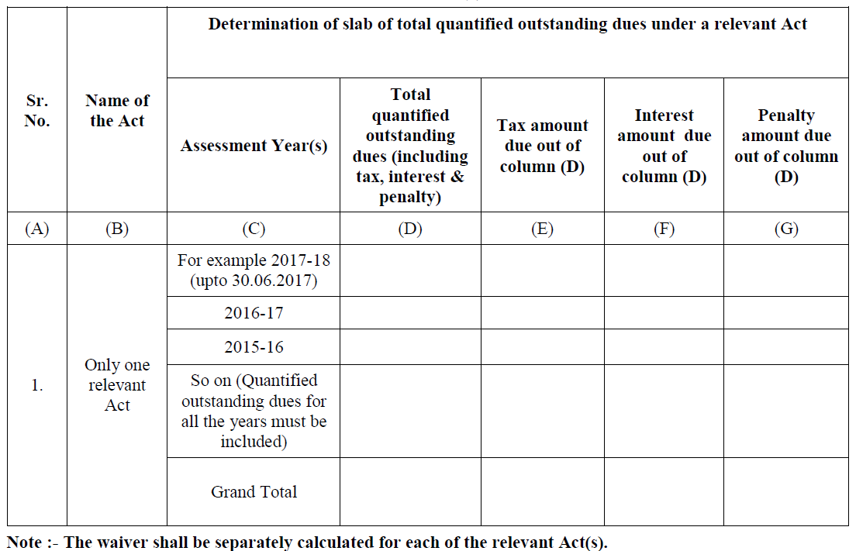
One Time Settlement Scheme – 2025
Schedule - I

Slide 22
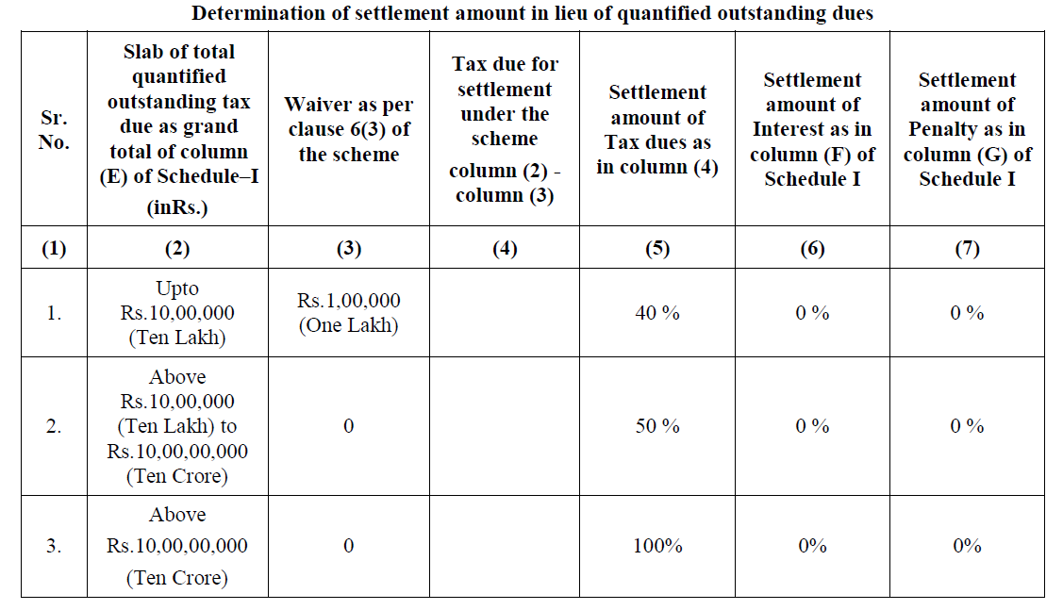
One Time Settlement Scheme – 2025
Schedule - IA

Slide 23
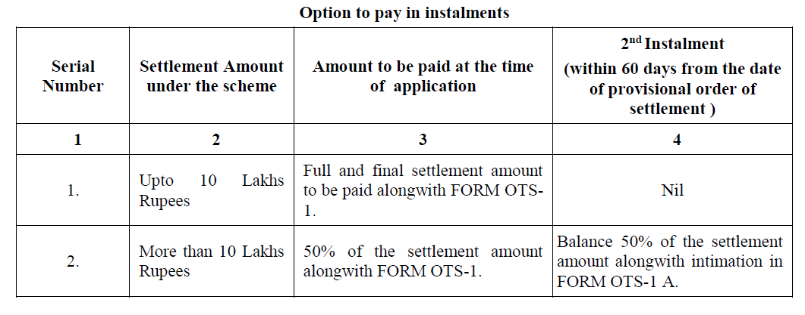
One Time Settlement Scheme – 2025
Schedule - II

