Slide 1


One Day Conference
Gurugram Branch of ICAI
Recent updates in TDS/TCS on International Transactions and on Business Perquisites
By CA Anshul Kumar Singhal (17 Nov. 2023)
+91-98997-84884
Anshul@CAinDelhi.com

Slide 2

Contents
 | Overview of legal provisions under ITA
 | How to register without PAN and Electronic Form 10F
 | TCS on Transactions covered under LRS
 | Impact of Supreme Court’s judgment on MFN Clause
 | Overview of TDS on Business Perquisites
1
2
3
4
5

Slide 3

Overview of legal provisions under ITA

Slide 4
Overview
Basic Provisions
Sections
Section 195
Section 271-I
Rules
Rule 37BB
Rule 37BC
Forms
Form 15CA
Rule 21AB
Form 15CB
Section 206AA
Form 10F

Slide 5
Overview
Objectives of section 195
Tax is collected at earliest point of time
There is no difficulty in collection of time at the time of assessment
To avoid loss of revenue – as non- residents may not have any assets in India from which subsequent recovery can be made
(CBDT circular No. 152 dated 27 November 1974)

Slide 6
Overview
Section 195(1)
  Any person responsible for paying to a non-resident, not being a company, or to a foreign company, any interest (not being interest referred to in section 194LB or section 194LC) or section 194LD or any other sum chargeable under the provisions of this Act (not being income chargeable under the head "Salaries") shall, at the time of credit of such income to the account of the payee or at the time of payment thereof in cash or by the issue of a cheque or draft or by any other mode, whichever is earlier, deduct income-tax thereon at the rates in force.
Payer
Any person responsible for paying
Payee
Non-resident not being a company, or
Nature of Payment
Interest or any other sum chargeable to tax
Includes NR, whether or not such NR has presence in India
Foreign Company
Excludes salary and interest referred to in section 194LB or section 194LC or section 194LD
Time of deduction
Payment or credit of income, whichever is earlier
Rate of deduction
Rates in force u/s 2(37A)
At the rate specified under the provision of Act/ DTAA/ 206AA

Slide 7
Overview
Section 195 (2) - Application by “Payer” to Assessing Officer (‘AO’) for determining of lower income for WHT certificate
Section 195 (3) - Application by “Payee” to AO for ‘NIL’ withholding certificate
Section 195 (4) – Validity period of certificate issued by AO
Section 195 (5) - Powers of CBDT to issue notifications
Section 195 (6) - Furnishing of information relating to payments
Section 195 (7) - Authority of board to specify class of person or cases to make application u/s 195(2)

Slide 8
Overview
Requirement for Form 15CA / 15CB arises from section 195(6) of the Act which reads as under:
195(6) “The person responsible for paying to a non-resident, not being a company, or to a foreign company, any sum, whether or not chargeable under the provisions of this Act, shall furnish the information relating to payment of such sum, in such form and manner, as may be prescribed.”
Analysis of section 195(6)
  Information to be furnished by the payer
  At the time of payment or credit
  Filing may be required even if payment is not taxable, say:
    Non-accrual in India (Sec. 9)
    Income accrued in India, but has been expressly exempted under the Act (Sec. 10)
    Income that enjoys treaty exemption (Sec. 90)
  Filing in prescribed form, manner (Rule 37BB)
  Finance Act 2015 introduced a new section 271-I to provide penalty of INR 1 lakh for failure to report or inaccurate reporting of remittances u/s 195

Slide 9
Overview
Section 206AA
  Notwithstanding anything contained in any other provisions of this Act, any person entitled to receive any sum or income or amount, on which tax is deductible under Chapter XVIIB (hereafter referred to as deductee) shall furnish his Permanent Account Number to the person responsible for deducting such tax (hereafter referred to as deductor), failing which tax shall be deducted at the higher of the following rates, namely:—
  (i) at the rate specified in the relevant provision of this Act; or
  (ii) at the rate or rates in force; or
  at the rate of twenty per cent.
Whether newly inserted Section 206AB applies on payments to non-residents
Proviso to Section 206AB(3)
Provided that the specified person shall not include a non-resident who does not have a permanent establishment in India
Whether Section 206AB applies to foreign company qualifying as resident?
Yes, it can apply. The exclusion is only for a non-resident.

Slide 10
Overview
Rule 37BC
  In the case of a non-resident, not being a company, or a foreign company (hereafter referred to as 'deductee') and not having permanent account number the provisions of section 206AA shall not apply in respect of payments in the nature of interest, royalty, fees for technical services, dividend and payments on transfer of any capital asset, if the deductee furnishes the details and the documents specified in sub-rule (2) to the deductor.
  The deductee referred to in sub-rule (1), shall in respect of payments specified therein, furnish the following details and documents to the deductor, namely:—
  (i) name, e-mail id, contact number;
  (ii) address in the country or specified territory outside India of which the deductee is a resident;
  a certificate of his being resident in any country or specified territory outside India from the Government of that country or specified territory if the law of that country or specified territory provides for issuance of such certificate;
  Tax Identification Number of the deductee in the country or specified territory of his residence and in case no such number is available, then a unique number on the basis of which the deductee is identified by the Government of that country or the specified territory of which he claims to be a resident.]

Slide 11
Overview
Form 10F
The information required in sub-rule (2) of Rule 37BC is required to be furnished in Form 10F which is a form prescribed in Rule 21AB r.w.s. 90(5) of the Act.
Notification No. 03/2022 dated 16 July 2022 mandated the filing of Form 10F through online portal of income tax department. The requirement of electronic filing was partially relaxed till 30 September 2023, after which electronic filing for Form 10F has become mandatory for all non-residents.
Non-residents who are not required to obtain PAN, can register on income tax portal of Form 10F required login credential which essentially meant that the non-resident would be required to obtain PAN
IF Form 10F is not filed electronically, then the benefit of Tax Treaties cannot be availed while withholding tax from payments to non-residents.
The tax rate under section 115A (on Royalty and Fee for Technical Services) has been increased to 20% (plus surcharge and cess) w.e.f. 1 April 2023

Slide 12
How to register without PAN

Slide 13
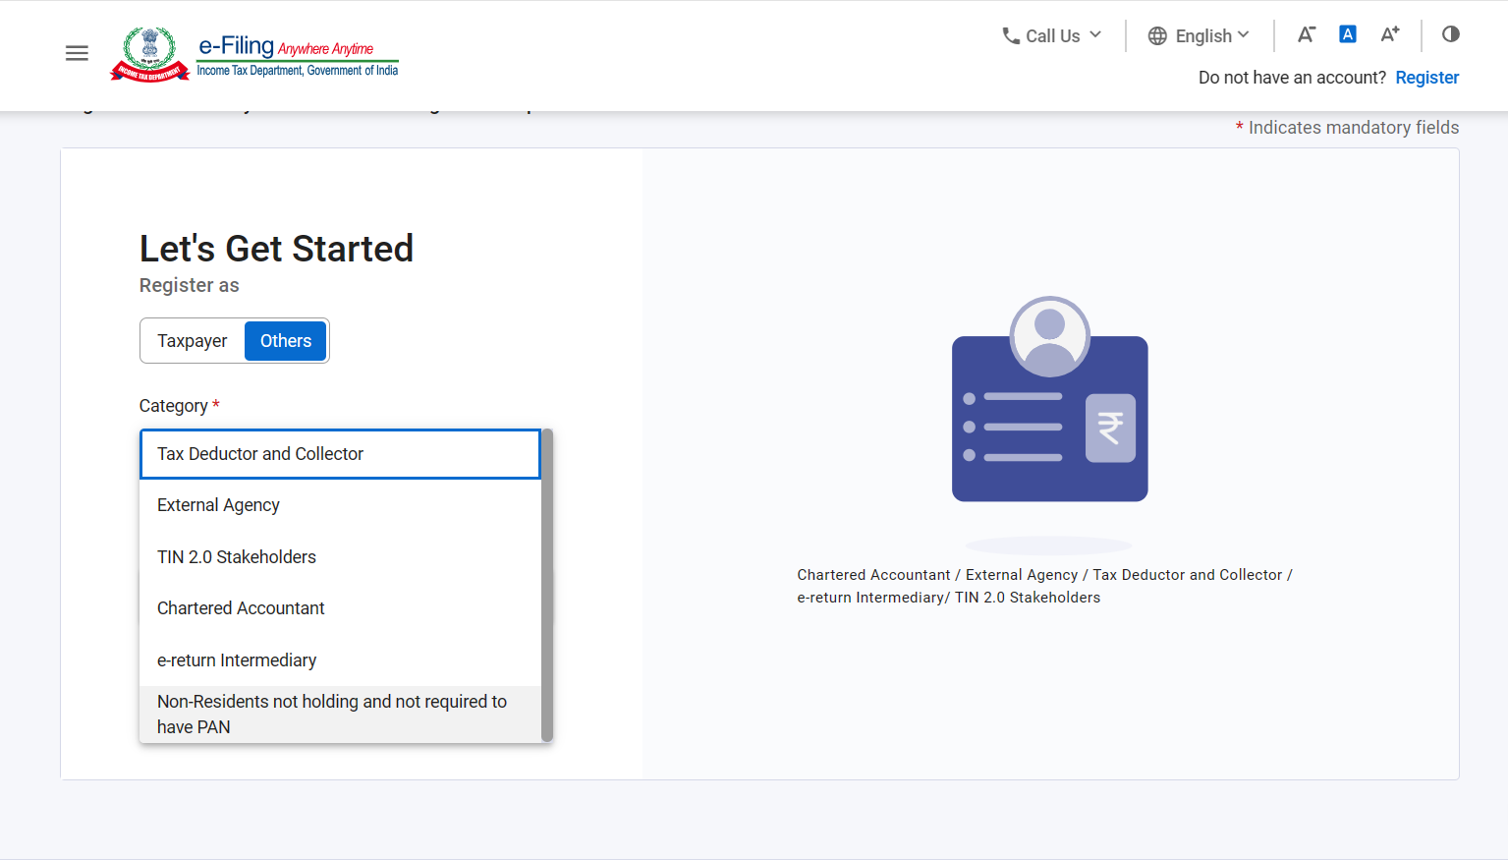
Registration without PAN

Slide 14
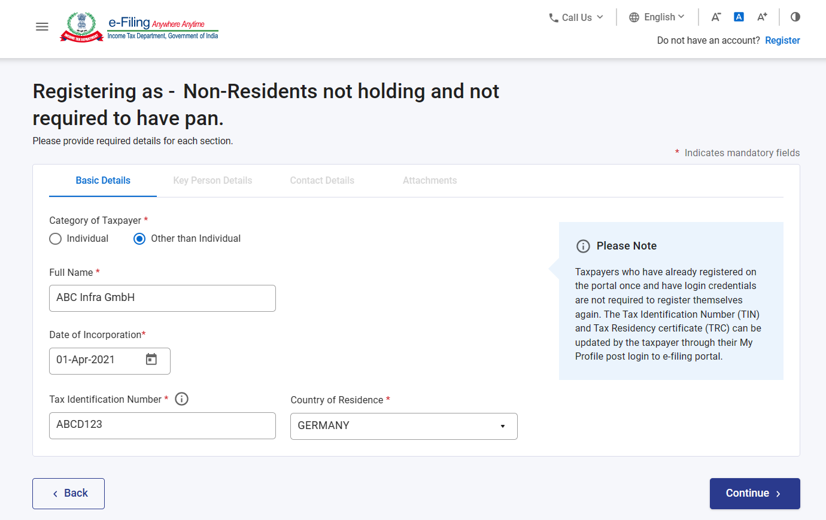
Registration without PAN

Slide 15
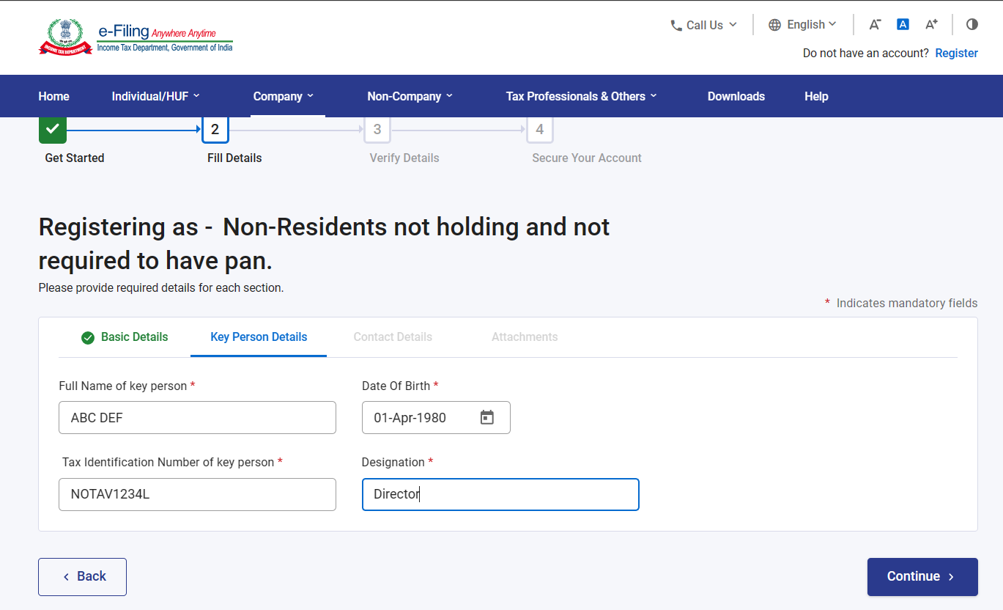
Registration without PAN

Slide 16
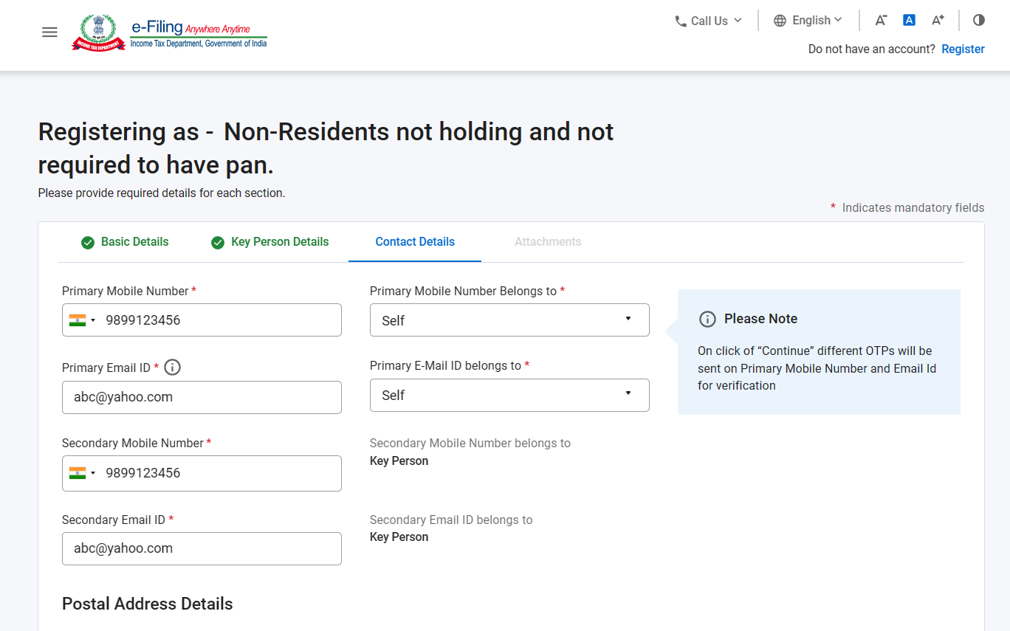
Registration without PAN

Slide 17
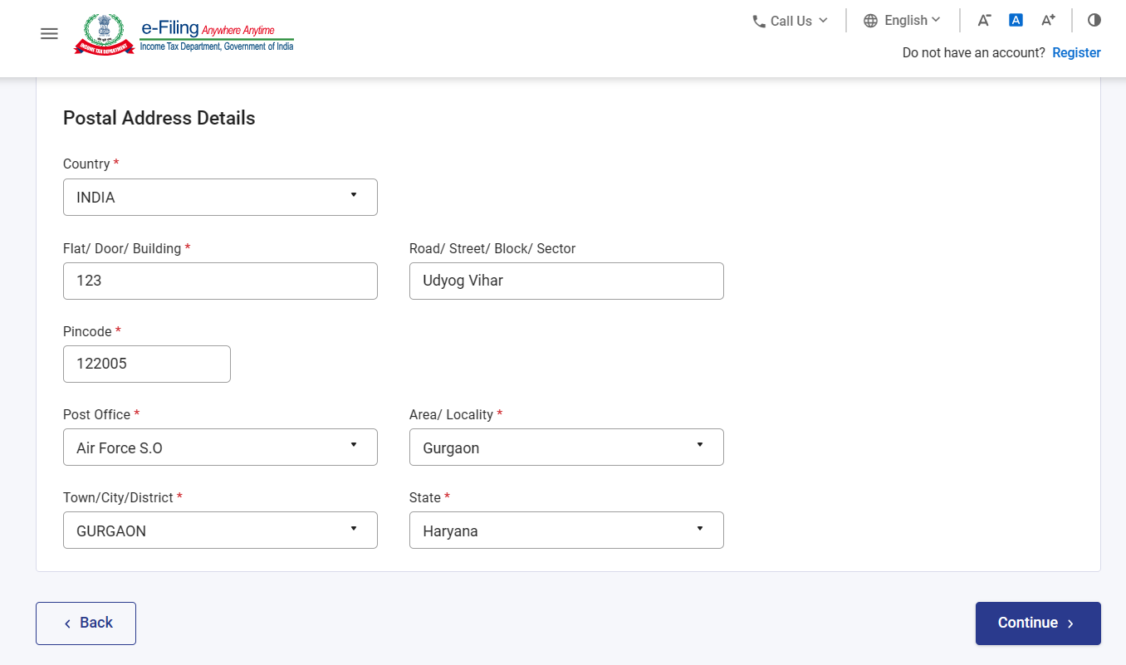
Registration without PAN

Slide 18
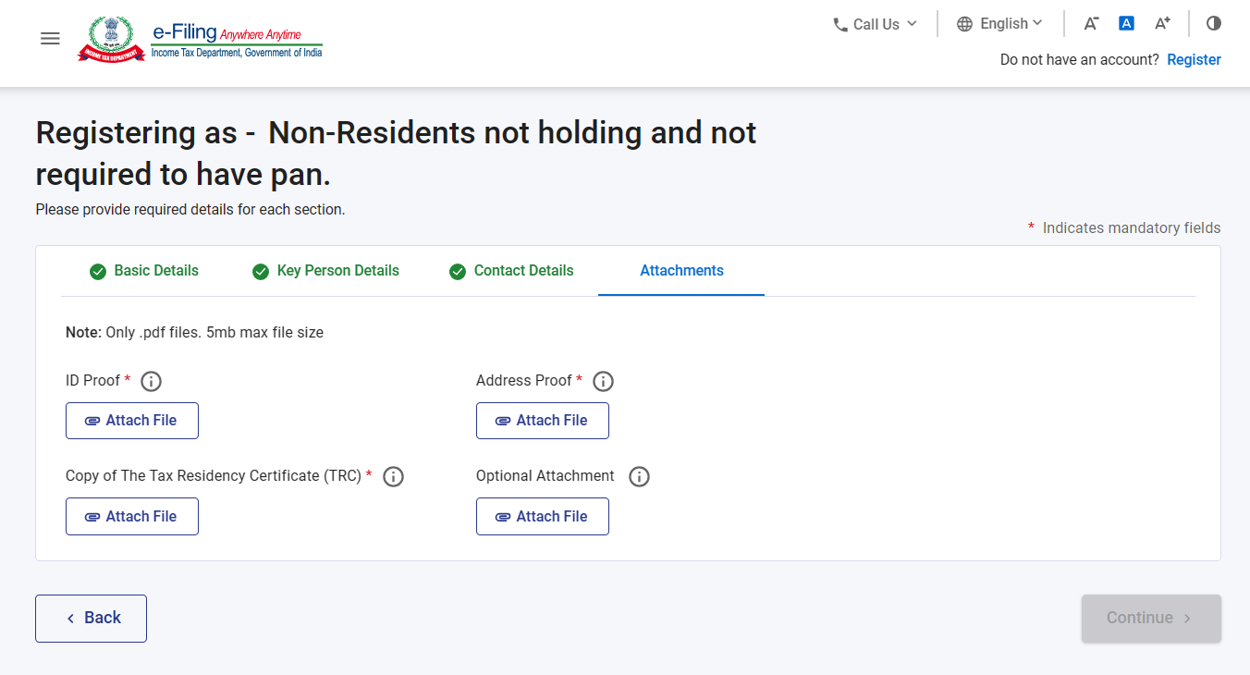
Registration without PAN

Slide 19
Registration without PAN
Once the documents have been uploaded, a unique ID will be generated, and the user will be prompted to create password.
Using these login credentials, electronic Form10F can be filed on income tax website.
Form 10F would not be required to be filed if all the requisite information is mentioned in the TRC.
A foreign party which is required to obtain PAN as per the provisions of Section 139A, is not legally eligible to obtain registration without PAN

Slide 20
Filing of Form 10F
Login to the income tax portal and go to –
eFile
Income Tax Forms
File Income Tax Forms
Persons not dependent on any Source of Income (Source of Income not relevant)
Form 10F

Slide 21
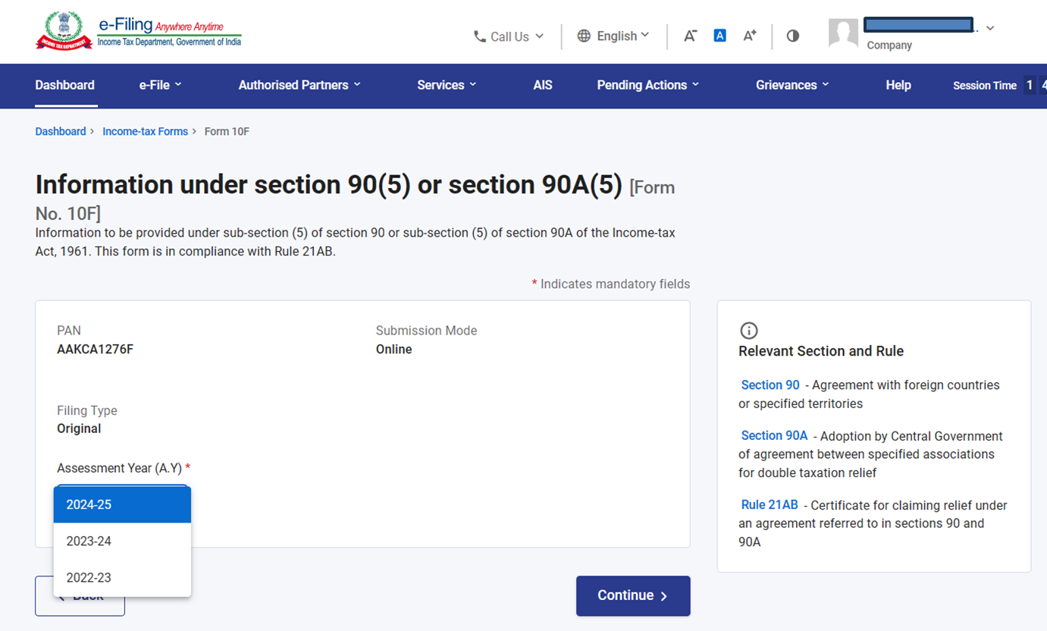
Filing of Form 10F

Slide 22
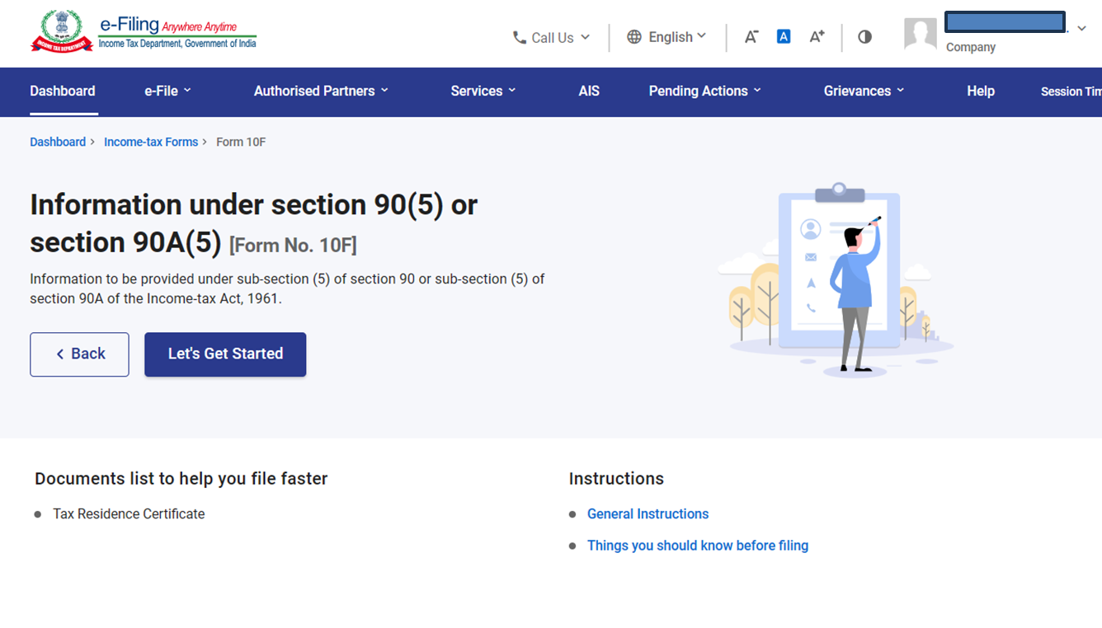
Filing of Form 10F

Slide 23
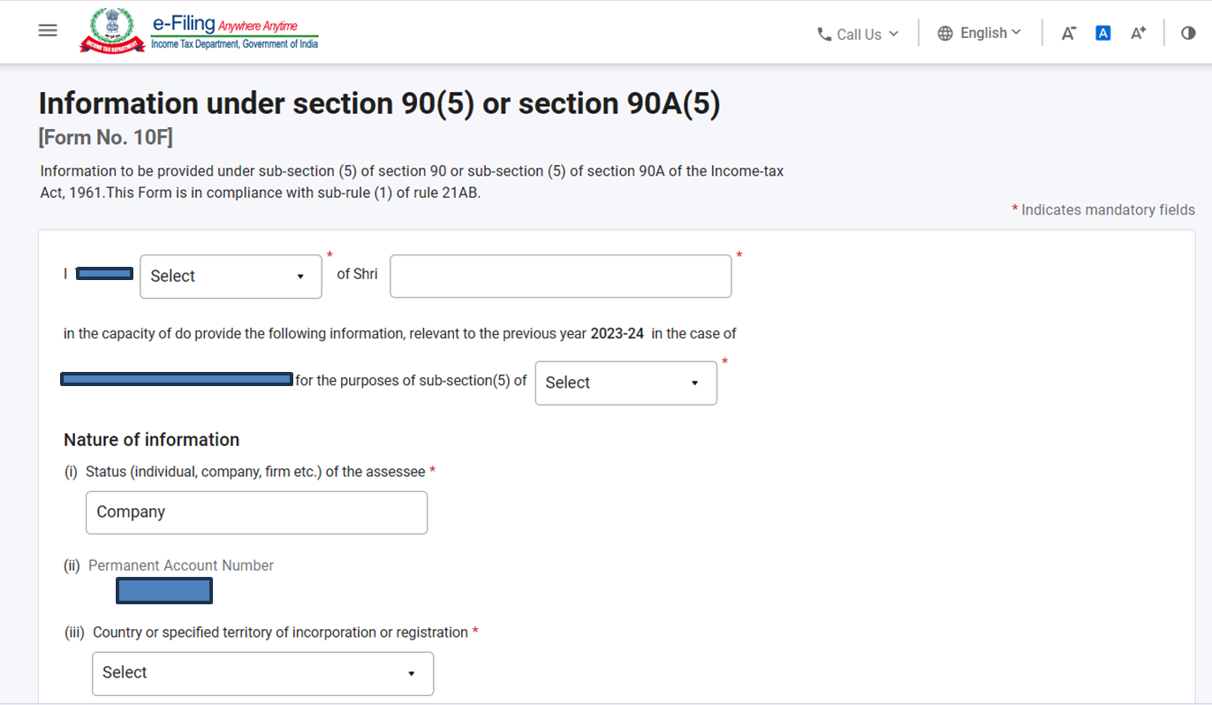
Filing of Form 10F

Slide 24
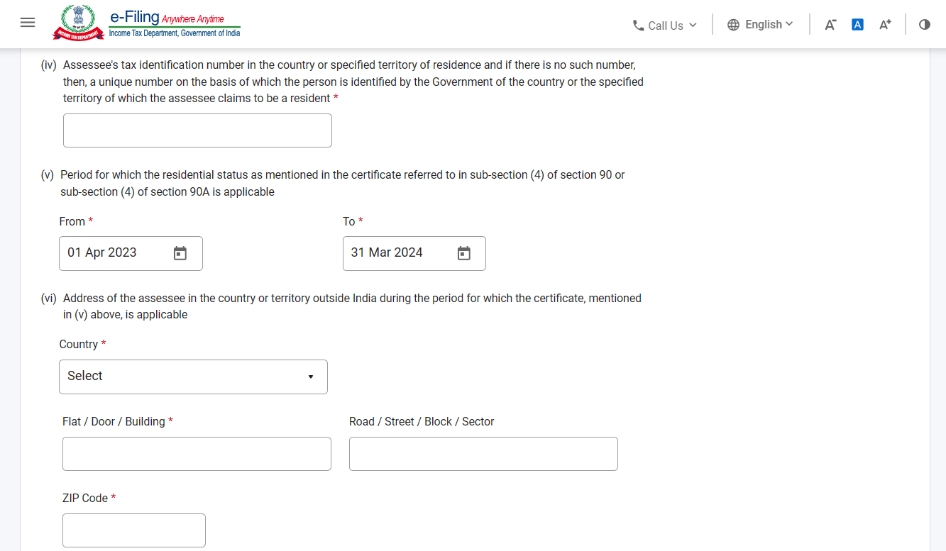
Filing of Form 10F

Slide 25
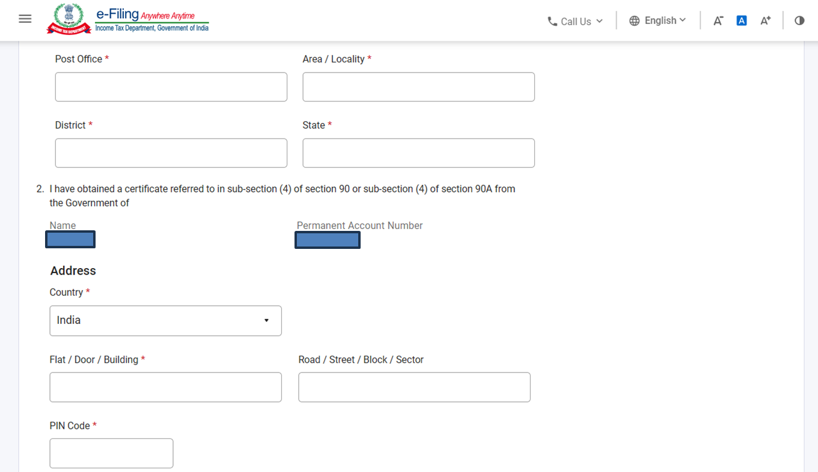
Filing of Form 10F

Slide 26
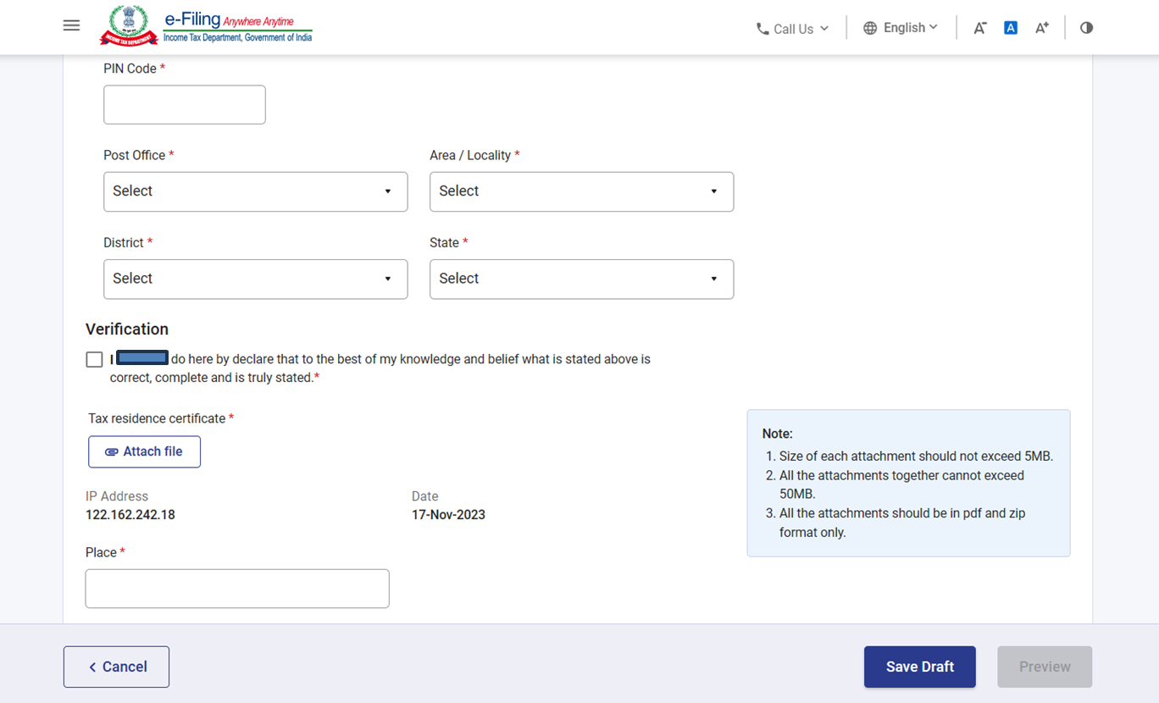
Filing of Form 10F

Slide 27

TCS on transactions covered under LRS

Slide 28
TCS on transactions covered under LRS
TCS on transactions covered under Liberalized Remittance Scheme (LRS) was introduced through Finance Act 2020
TCS was to be collected at the rate of 5% on LRS transactions over and above the threshold limit of INR 7 Lakh (excluding overseas tour packages, where this threshold was not applicable).
Finance Act,2023 amended sub-section (1G) of section 206C to, interalia,
(i) increase the rate of TCS from 5% to 20% for remittance under LRS as well as for purchase of overseas tour program package; and
(ii) remove the threshold of INR 7 Lakh for triggering TCS on LRS.
The above changes did not apply when the remittance is for education and medical purpose.
The amendment also proposed to cover international payments made through credit cards.

Slide 29
TCS on transactions covered under LRS
Representations were made to the Govt. regarding the practical difficulties arising from the amendments made.
To address these issues, a Press Release dated 28 June 2023 was issued by Ministry of Finance wherein the threshold of INR 7 Lakh per financial year per individual shall be restored for all LRS transactions (other than purchase of overseas tour package)
Beyond this Rs 7 lakh threshold, TCS shall be at the rate of -
a) 0.5% (if remittance for education is financed by loan taken from a financial institution);
b) 5% (in case of remittance for education/medical treatment);
c) 20% for others.
For purchase of overseas tour program package, the TCS shall continue to apply at the rate of 5% for the first INR 7 Lakh per individual per annum; the 20% rate will only apply for expenditure above this limit.

Slide 30
TCS on transactions covered under LRS
Press Release dated 28 June 2023 also postponed the applicability of TCS on International Credit Card payments, till further order.
The CBDT issued Circular No. 10 of 2023, dated 30 June 2023 to endorse the provisions mentioned in the aforesaid Press Release
Comparison of old and new TCS rates is as follows:
Nature of Payment (1) | Earlier rate before Finance Act,2023 (2) | New rate w.e.f. 1st October 2023 (3)
LRS for education, financed by loan from financial institution | Nil upto INR 7 Lakh 0.5% above INR 7 Lakh | Nil upto INR 7 Lakh 0.5% above INR 7 Lakh
LRS for Medical treatment/ education (other than financed by loan) | Nil upto INR 7 Lakh 5% above INR 7 Lakh | Nil upto INR 7 Lakh 5% above INR 7 Lakh
LRS for other purposes | Nil upto INR 7 Lakh 5% above INR 7 Lakh | Nil upto INR 7 Lakh 20% above INR 7 Lakh
Purchase of Overseas tour program package | 5% (without threshold) | 5% till INR 7 lakh 20% thereafter
Note: TCS rate mentioned in Column 2 were applicable till 30th Sept. 2023

Slide 31
Impact of Supreme Court’s judgment on MFN Clause

Slide 32
Concept of MFN Clause
Operation of MFN Clause
DTAA between A and B consists of MFN clause
DTAA between A and C confers a more favorable treatment to resident of C under taxation laws of A as compared to resident of B under the DTAA between A and B in relation to a particular income
Resident of B can invoke DTAA between A and C to obtain a similar tax treatment
By invoking DTAA between A and C, the resident of B can claim such benefits as were not available under the DTAA between A and B.

Slide 33
Concept of MFN Clause
Benefits generally arising from MFN clause
Tax rate
Scope of Applicability of Treaty clauses
Allowability of Deduction / Expenditure

Slide 34
MFN Clause – Earlier judgments
The restrictive provisions of other relevant DTAAs, such as UK and USA having ‘make available clause’ in FTS provisions were held to be automatically applicable in India-France DTAA. [Steria (India) Ltd vs. CIT [2016] 386 ITR 390 (Delhi)]
Tax treaties of India with Belgium, Hungary, Spain, Sweden also had similar MFN clause as that of France.
In India-Netherlands Treaty, the beneficial provisions of MFN also extended to taxability of Dividends if India signs a better Treaty with another country which is a member of OECD.
India signed a Treaty with Slovenia wherein the tax rate on Dividends is restricted to 5%. Slovenia was not a member of OECD when the treaty was signed, but later on it became a member of OECD.
Delhi High Court held that the provisions of MFN are to be read as on the date of giving effect to such provisions and not at the time of signing of the Treaty. The benefit of lower rate of tax on Dividends was provided. [Concentrix Services Netherlands B.V. : [2021] 434 ITR 516 (Delhi)]

Slide 35
MFN Clause – Supreme Court ruling in Nestle’s case
The Supreme Court has held that for MFN clause to come in effect, a separate notification is required to be issued under Section 90 of the Income-tax Act.
The Supreme Court also overruled the High Court’s order in respect of Dividends and held that when the India-Netherlands DTAA was signed, Slovenia was not an OECD member. Thus, the benefits given to Slovenia, which became an OECD member later, do not apply to the India-Netherlands DTAA.
[Assessing Officer vs. Nestle SA [2023] 155 taxmann.com 384 (SC)]
The Judgment of Supreme Court poses challenges to the non-resident taxpayers as well as the Indian payers who have taken benefit of MFN clause in earlier years while remitting foreign payments.

Slide 36
Overview of TDS on Business Perquisites

Slide 37
Overview – Section 194R
Provider of the benefit or perk is required to withhold tax on such benefits or perks.
Benefit or perk may or may not be convertible into money. Even monetary benefits or perks are covered within the ambit of section 194R.
Benefit or perk must arise to recipient from business or exercise of profession.
Recipient of benefit or perk must be resident. Non-residents recipients are not covered.
TDS is applicable at the rate of 10% of aggregate value of such benefit or perk.
Tax to be deducted before providing such benefit or perk.
In case of benefit or perk in kind or cash element not sufficient to meet TDS, deductor to ensure deposit of tax before release of benefit.

Slide 38
Overview – Section 194R
Threshold for recipient - INR 20,000 (in aggregate, per annum) in the hands of each recipient.
Exclusion for individual or HUF deductor – If the turnover does not exceed:
INR 1 Cr. in case of business and
INR 50 lakhs in case of profession
Power to issue guidelines – Guidelines issued in Circular 12 of 2022
Any guidelines issued under this section are to be laid before both Houses of Parliament

Slide 39


CA Anshul Kumar Singhal
Partner
Lalit Vanjani & Co.
Chartered Accountants
Phone: +91 9899 784 884
Email: anshul@caindelhi.com
  Professional experience:
  Anshul Kumar has 18 years of experience with him in corporate tax and transfer pricing matters and has worked with Big4 firms for more than 13 years.
  Anshul believes in technical thoroughness and assists various multinational clients in tax planning, compliance and litigation. He also represents clients at different income tax appellate levels, including tax Tribunals.
  Anshul has vast experience of supporting various multinational companies in formulating their tax and transfer pricing strategies. Anshul has hands-on experience in setting up global transfer pricing policy for his clients.
  He has undertaken various tax health check assignments and advised clients on best compliance practices.
  Anshul is also well versed in foreign exchange regulations of India and assists clients in advising on efficient modes of investment/repatriation strategies.
  Anshul has rich experience of serving clients from various sectors like telecommunication, manufacturing, chemicals, information technology, infrastructure, life-sciences and healthcare, investment funds, NBFCs, airlines, charitable organizations, etc.
Professional qualifications and affiliations:
  Honor’s Graduate in Commerce from Delhi University
  Member of the Institute of Chartered Accountants of India
  Regular speaker in seminars organized by various branches of Institute of Chartered Accountants of India as well as by renowned academic institutions/organizations

Slide 40

Thank You
Disclaimer
This publication contains information in summary form and is therefore intended for general guidance only. It is not intended to be a substitute for detailed research or the exercise of professional judgment. Neither Lalit Vanjani & Co. (‘LVC’) nor any of its Partners/employees can accept any responsibility for loss occasioned to any person acting or refraining from action as a result of any material in this publication. On any specific matter, reference should be made to the appropriate advisor.
Contact at anshul@CAinDelhi.com or call us at +91-98997-84884
www.CAinDelhi.com

Slide 41
Section 139A – Relevant Extract
139A. (1) Every person,—
(i) if his total income or the total income of any other person in respect of which he is assessable under this Act during any previous year exceeded the maximum amount which is not chargeable to income-tax; or
(ii) carrying on any business or profession whose total sales, turnover or gross receipts are or is likely to exceed five lakh rupees in any previous year; or
(iii) who is required to furnish a return of income under sub-section (4A) of section 139; or
(iv) being an employer, who is required to furnish a return of fringe benefits under section 115WD; or
(v) being a resident, other than an individual, which enters into a financial transaction of an amount aggregating to two lakh fifty thousand rupees or more in a financial year; or
(vi) who is the managing director, director, partner, trustee, author, founder, karta, chief executive officer, principal officer or office bearer of the person referred to in clause (v) or any person competent to act on behalf of the person referred to in clause (v); or
(vii) who intends to enter into such transaction as may be prescribed67 by the Board in the interest of revenue,
and who has not been allotted a permanent account number shall, within such time, as may be prescribed, apply to the Assessing Officer for the allotment of a permanent account number.
Back

Slide 42
Section 90(5) – Relevant Extract
90.
(4) An assessee, not being a resident, to whom an agreement referred to in sub-section (1) applies, shall not be entitled to claim any relief under such agreement unless a certificate of his being a resident in any country outside India or specified territory outside India, as the case may be, is obtained by him from the Government of that country or specified territory.
(5) The assessee referred to in sub-section (4) shall also provide such other documents and information, as may be prescribed
and who has not been allotted a permanent account number shall, within such time, as may be prescribed, apply to the Assessing Officer for the allotment of a permanent account number.
Back

Slide 43
Rule 21AB – Relevant Extract
Certificate for claiming relief under an agreement referred to in sections 90 and 90A.
21AB. (1) Subject to the provisions of sub-rule (2), for the purposes of sub-section (5) of section 90 and sub-section (5) of section 90A, the following information shall be provided by an assessee in Form No. 10F, namely:—
(i) Status (individual, company, firm etc.) of the assessee;
(ii) Nationality (in case of an individual) or country or specified territory of incorporation or registration (in case of others);
(iii) Assessee's tax identification number in the country or specified territory of residence and in case there is no such number, then, a unique number on the basis of which the person is identified by the Government of the country or the specified territory of which the asseessee claims to be a resident;
(iv) Period for which the residential status, as mentioned in the certificate referred to in sub-section (4) of section 90 or sub-section (4) of section 90A, is applicable; and
(v) Address of the assessee in the country or specified territory outside India, during the period for which the certificate, as mentioned in (iv) above, is applicable.
(2) The assessee may not be required to provide the information or any part thereof referred to in sub-rule (1) if the information or the part thereof, as the case may be, is contained in the certificate referred to in sub-section (4) of section 90 or sub-section (4) of section 90A.
Back

