Slide 1
TRANSFER PRICING
EMERGING TRENDS AND COMPLIANCE REQUIREMENTS
RAJIV BHUTANI
14TH OCTOBER 2023

Slide 2


TABLE OF CONTENTS
01.
Transfer Pricing compliance - Documentation
02.
Transfer Pricing compliance - Certification
03.
Transfer Pricing compliance – Master File & CbCR
04.
Emerging issues in Transfer Pricing
05.
Indian APA Program
06.
Indian MAP Regime

Slide 3
TRANSFER PRICING COMPLIANCE – DOCUMENTATION

Slide 4
TRANSFER PRICING COMPLIANCE
DOCUMENTATION REQUIREMENTS
Entity related
Price related
Transaction related
Business overview of the Group
Profile of Associated Enterprises
Business overview of the Indian entity
Industry overview
Transaction terms
Functional analysis
Economic analysis
Forecasts/ budgets
Inter-company Agreements
Invoices
Pricing related correspondence
Need-benefit documentation
Back-up workings
Third party supporting documents
Contemporaneous TP Documentation – Due on October 31st
Applicable if value of international transactions exceed INR 1 Crore.
TP Certificate – Due on October 31st
Applicable with even INR 1 international transaction.

Slide 5
TRANSFER PRICING COMPLIANCE
PROCESS
Gathering Background Information
1
3
4
5
6
2
TP Certification
Functional Analysis
Financial Analysis
Industry Analysis
Economic Analysis

Slide 6
TRANSFER PRICING Documentation
KEY CONSIDERATIONS
STAGE 1
STAGE 2
STAGE 3
STAGE 4
STAGE 5
Pre-Project Planning
Information gathering
Functional Analysis
Comparable data gathering
Analysis
Issuance of TP Documentation
Preparation of Project Plan
Functional questionnaires
FAR discussions with management
Agreement reviews
Characterisation of entities
Assessment of Internal comparable data
Search strategy for external comparable analysis
Assessing databases
Comparison with Company’s data
Determination of arm’s length price
Consultation with management
Finalization of TP Documentation

Slide 7
TRANSFER PRICING Documentation
METHODS FOR COMPUTING ARM’S LENGTH PRICE
Comparability Requirements Approach Practical Applicability
Comparable Uncontrolled Price (CUP) Method
Very high
Prices are compared
Low
Resale Price Method (RPM)
High
Gross margins are compared
Low
Cost Plus Method (CPM)
High
Gross margins are compared
Low
Profit Split Method (PSM)
Medium to High
Profit margins are compared
Low
Transactional Net Margin Method (TNMM)
Medium
Net Profit margin are compared
High
Other Method
Very High
Quotations are compared
High

Slide 8

MOST APPROPRIATE METHOD
COMPARABLE UNCONTROLLED PRICE METHOD
Most Direct Method and Reliable Method
Prices are benchmarked without any reference to the profits
Requires strict comparability in products, contractual terms, economic terms, etc
Key considerations around – Volume or quantity of products, Credit terms, Geographic market, Other terms of contract
Strengths: Two-Sided Analysis, Avoids the issue of selecting Tested Party
Weakness: Availability of comparable data
Internal CUP as well as External CUP

Slide 9

MOST APPROPRIATE METHOD
RESALE PRICE METHOD
Compares the ‘resellers’ Gross Margin
Preferred method for a distributors - buying finished goods from a group company and reselling in the market
Comparability is relatively less dependent on ‘product comparability’ and additional emphasis is on ‘similarity of functions’ performed & risks assumed
Used when reseller does not add substantial value to the goods and does not apply intangible assets to add value
Difficult to apply where goods are further processed before resale

Slide 10

MOST APPROPRIATE METHOD
COST PLUS METHOD
Compares and identifies mark-up earned on direct and indirect costs of production incurred with that of comparable independent companies
Preferred method in case:
Semi-finished goods sold between parties
  Long term buy and supply arrangements
  Provision of services
Not applied in transaction involves full fledged manufacturer. i.e Supplier is contract/toll manufacturer
Comparability is relatively less dependent on strict product comparability and additional emphasis is on similarity of functions performed & risks assumed

Slide 11

MOST APPROPRIATE METHOD
PROFIT SPLIT METHOD
PSM is applied in cases:
  involving transfer of unique intangibles or
  multiple transactions that cannot be evaluated separately
PSM requires selection and application of appropriate allocation keys for splitting profits amongst the members of the MNE group contributing to generation of combined profits.
Strengths of PSM:
Offers solutions for integrated operations
Helps share profits for unique intangibles contributed
Weaknesses of PSM:
Difficulty in application – selection of allocation keys
Reluctance of tax authorities to accept

Slide 12

MOST APPROPRIATE METHOD
TRANSACTIONAL NET MARGIN METHOD
Most frequently used method, due to lack of availability of data for application of other methods
Examines net operating profit from transactions as a percentage of a certain base (can use different bases i.e., costs, turnover, etc.)
Broad level of product comparability and high level of functional comparability
Applicable for most categories of transaction and often used to supplement analysis under other methods
Grouping of transaction - Relevant controlled transactions require to be aggregated to test whether the controlled transaction earn a reasonable margin as compared to uncontrolled transaction

Slide 13

MOST APPROPRIATE METHOD
OTHER METHOD
Rule 10AB - “any method which takes into account the price which has been charged or paid, or would have been charged or paid, for the same or similar uncontrolled transaction, with or between non-associated enterprises, under similar circumstances, considering all the relevant facts."
Implies – “Quotations” rather than “actual prices” charged or paid can also be used as comparables
To maintain proper documentation specifying the rejection reasons for non-application of other five methods and appropriateness of the “Other Method”

Slide 14
TRANSFER PRICING ANALYSIS
PRACTICAL CONSIDERATIONS
Based upon functional characterisation
Has to be a Least complex entity
Records & financial data should be easily available
Varied depending upon nature of transaction
Should ‘not’ be a tainted transaction
Examples:
  Net Operating Profit on Cost
  Net Operating Profit on Revenue
  Gross Profit on Revenue
More than 6 comparables – Range is to be seen (35th to 65th Percentile)
If arm’s length price outside range; Median needs to be compared
Less than 6 comparables – Mean is to be compared (have a benefit of 3% range on transaction price)
Examples of Non-operating nature:
  Forex fluctuation gain/ loss
  Bank charge or interest
  Gain/ loss on sale of investment
  Extraordinary items
Tested Party
Profit Level Indicator
Concept of Range, Median, Mean
Operating vs. Non-operating nature

Slide 15
TRANSFER PRICING COMPLIANCE – CERTIFICATION

Slide 16
TRANSFER PRICING CERTIFICATION (Form No. 3CEB)
REQUIREMENT
To be obtained and filed by every person entering into international transactions (even INR 1)
Due date for uploading it with Indian Income Tax Authorities is October 31st
Clause | Transactions related to:
Clause 10 | List of Associated Enterprises
Clause 11 | Tangible property
Clause 12 | Intangible property
Clause 13 | Services
Clause 14 | Lending/ borrowing of money
Clause 15 | Corporate guarantee
Clause 16 | Marketable securities
Clause 17 | Mutual agreements
Clause 18 | Business restructuring
Clause 19 | Any other transaction
Clause 20 | Deemed international transaction
Clause 21 | List of Domestic related parties
Clause 22 | Transfer of any goods or services
Clause 23 | SDT in the nature of any business
Clause 24 | SDT between persons referred to section 115BAB(6)
Clause 25 | SDT not specifically referred above
Penalties
Failure in filing of Form No. 3CEB | INR 100,000
Failure to maintain TP documentation or TP Certification or maintenance of incorrect documentation | 2% of value if international transactions
Concealment of income or furnishing inadequate particulars of income in respect of Arm’s length price (ALP) adjustments | 100% to 300% of tax sought to be evaded

Slide 17
TRANSFER PRICING CERTIFICATION (Form No. 3CEB)
KEY CONSIDERATIONS
Clause 10
List of associated enterprises with whom the assessee has entered into international transactions
Name of the associated enterprise.
Nature of the relationship with the associated enterprise as referred to in section 92A(2).
Brief description of the business carried on by the associated enterprise.

Slide 18
TRANSFER PRICING CERTIFICATION (Form No. 3CEB)
KEY CONSIDERATIONS
Clause 11
Particulars in respect of transactions in tangible property
(A) International transaction(s) in respect of purchase/ sale of raw material, consumables or any other supplies for assembling or processing/manufacturing of goods or articles.
Name Address Description Quantity Amount Method
(B) International transaction(s) in respect of purchase/sale of traded/finished goods.
Name Address Description Quantity Amount Method
(C) International transaction(s) in respect of purchase, sale, transfer, lease or use of any other tangible property.
Name Address Description Quantity Amount Method

Slide 19
TRANSFER PRICING CERTIFICATION (Form No. 3CEB)
KEY CONSIDERATIONS
Clause 12
Particulars in respect of transactions in intangible property
Requirements of Clause
Name of associated enterprise
Address of associated enterprise
Tax Identification No. of associated enterprise
Description of IP
Nature of transaction
Amount
Method adopted for arm’s length price
Few Examples of Transactions:
Tradename or Brand royalty
Technical fee
Technology License fee
Fee for Designs/ Drawings

Slide 20
TRANSFER PRICING CERTIFICATION (Form No. 3CEB)
KEY CONSIDERATIONS
Clause 13
Particulars in respect of providing of services
Requirements of Clause
Name of associated enterprise
Address of associated enterprise
Tax Identification No. of associated enterprise
Description of service
Amount
Method adopted for arm’s length price
Few Examples of Transactions:
Software development service
IT enabled services
Marketing support services
Back-office support service
Engineering service
Technical services

Slide 21
TRANSFER PRICING CERTIFICATION (Form No. 3CEB)
KEY CONSIDERATIONS
Clause 14
Particulars in respect of lending or borrowing of money
Requirements of Clause
Name of associated enterprise
Address of associated enterprise
Tax Identification No. of associated enterprise
Nature of financing arrangement
Currency
Interest rate
Amount
Method adopted for arm’s length price

Slide 22
TRANSFER PRICING CERTIFICATION (Form No. 3CEB)
KEY CONSIDERATIONS
Clause 15
Particulars in respect of transactions in the nature of guarantee
Requirements of Clause
Name of associated enterprise
Address of associated enterprise
Tax Identification No. of associated enterprise
Nature of guarantee arrangement
Currency
Compensation/ guarantee fee
Method adopted for arm’s length price

Slide 23
TRANSFER PRICING CERTIFICATION (Form No. 3CEB)
KEY CONSIDERATIONS
Clause 16
Particulars in respect of international transactions of purchase or sale of marketable securities, issue and buyback of equity shares, optionally convertible/ partially convertible/ compulsorily convertible debentures/ preference shares
Requirements of Clause
Name of associated enterprise
Address of associated enterprise
Tax Identification No. of associated enterprise
Nature of arrangement
Currency
Consideration
Method adopted for arm’s length price
Few Examples of Transactions:
Share capital infusion
Investment made in share capital

Slide 24
TRANSFER PRICING CERTIFICATION (Form No. 3CEB)
KEY CONSIDERATIONS
Clause 17
Particulars in respect of mutual agreement or arrangement
Requirements of Clause
Name of associated enterprise
Address of associated enterprise
Tax Identification No. of associated enterprise
Description of such mutual agreement or arrangement
Amount
Method adopted for arm’s length price
Few Examples of Transactions:
Management cross charge
Any allocation of charge from/ to associated enterprise

Slide 25
TRANSFER PRICING CERTIFICATION (Form No. 3CEB)
KEY CONSIDERATIONS
Clause 18
Particulars in respect of international transactions arising out/ being part of business restructuring or reorganizations
Requirements of Clause
Name of associated enterprise
Address of associated enterprise
Tax Identification No. of associated enterprise
Nature of transaction
Agreement in relation to such business restructuring
Terms of business restructuring
Method

Slide 26
TRANSFER PRICING CERTIFICATION (Form No. 3CEB)
KEY CONSIDERATIONS
Clause 19
Particulars in respect of any other transaction including the transaction having a bearing on the profits, income, losses or assets of the assessee
Requirements of Clause
Name of associated enterprise
Address of associated enterprise
Tax Identification No. of associated enterprise
Description of transaction
Amount
Method adopted for arm’s length price
Few Examples of Transactions:
Reimbursement of expenses
Recovery of expenses
Pass through costs

Slide 27
TRANSFER PRICING CERTIFICATION (Form No. 3CEB)
KEY CONSIDERATIONS
Clause 20
Particulars of deemed international transactions
Requirements of Clause
Name of person other than associated enterprise
Address of person other than associated enterprise
Tax Identification No. of such other person
Description of transaction
Amount
Method adopted for arm’s length price

Slide 28
TRANSFER PRICING CERTIFICATION (Form No. 3CEB)
KEY CONSIDERATIONS
Clause 21 to 25
Specified domestic transactions
Requirements of Clauses
Details of domestic related parties
Details regarding specified domestic transaction with any undertaking or unit or enterprise or eligible business of the assessee [as referred to in section 80A (6), 80IA(8) or section 10AA)]
Details regarding specified domestic transaction with any associated enterprise which has resulted in more than ordinary profits to an eligible business to which section 80IA (10) or section 10AA applies
Details regarding specified domestic transaction between the persons referred to in sub-section (6) of section 115BAB

Slide 29
TRANSFER PRICING COMPLIANCE – MASTER FILE & CbCR

Slide 30
MASTER FILE AND COUNTRY-bY-COUNTRY-REPORT (CBCR)
MASTER FILE
Group’s document – a policy level document
No financial data required
OECD Guidance plus India specific requirements
Applicability:
  Group’s revenue exceeds INR 500 Cr; and
  Taxpayer’s related party transaction exceed INR 50 Cr
CBCR
Group’s document – with a lot of financial data
Focuses on appropriate allocation of substance with the remuneration
Applicability:
  Group’s revenue exceeds INR 6,400 Cr
Master File (Designation Intimation)
Form 3CEAB
Master File (Part A)
Form 3CEAA
Master File (Part B)
Form 3CEAA
CbCR (Intimation)
Form 3CEAC
CbCR
Form 3CEAD
October 31st
November 30th
November 30th
January 31st
March 31st

Slide 31
EMERGING ISSUES IN TRANSFER PRICING

Slide 32
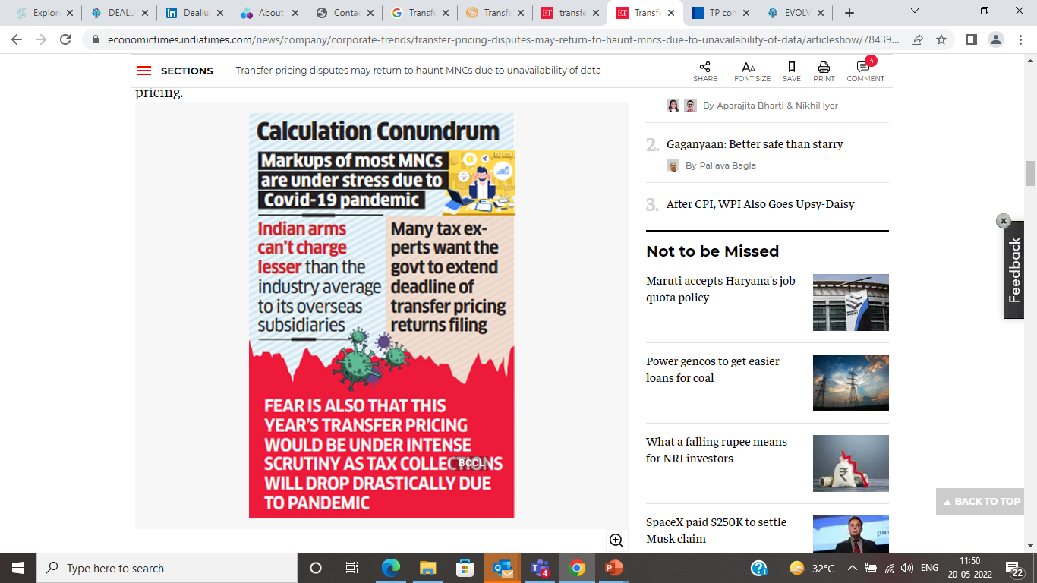
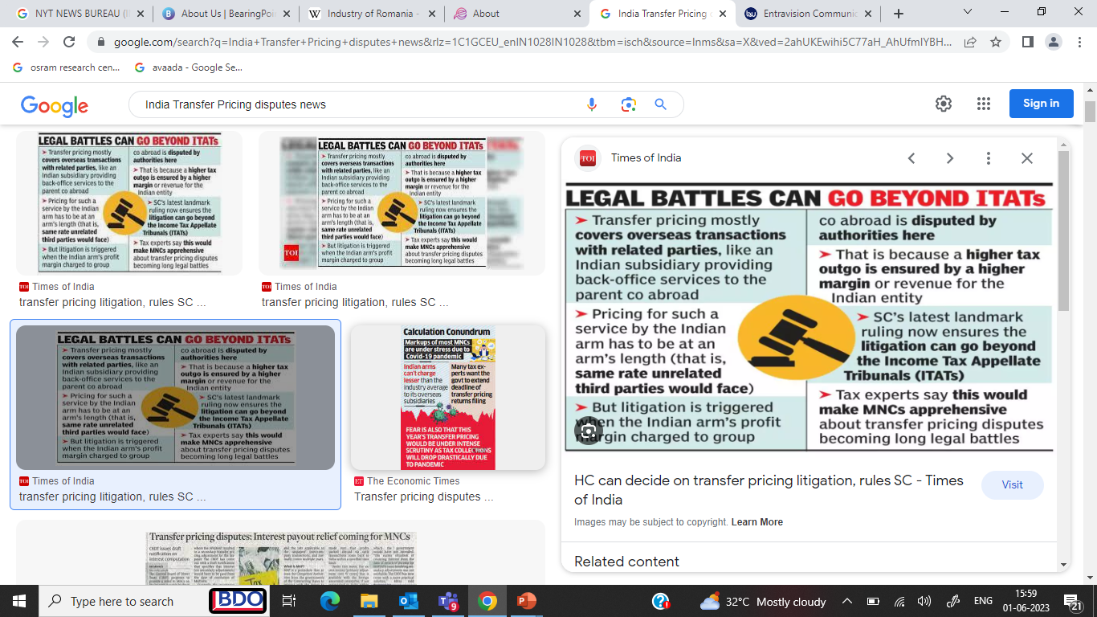
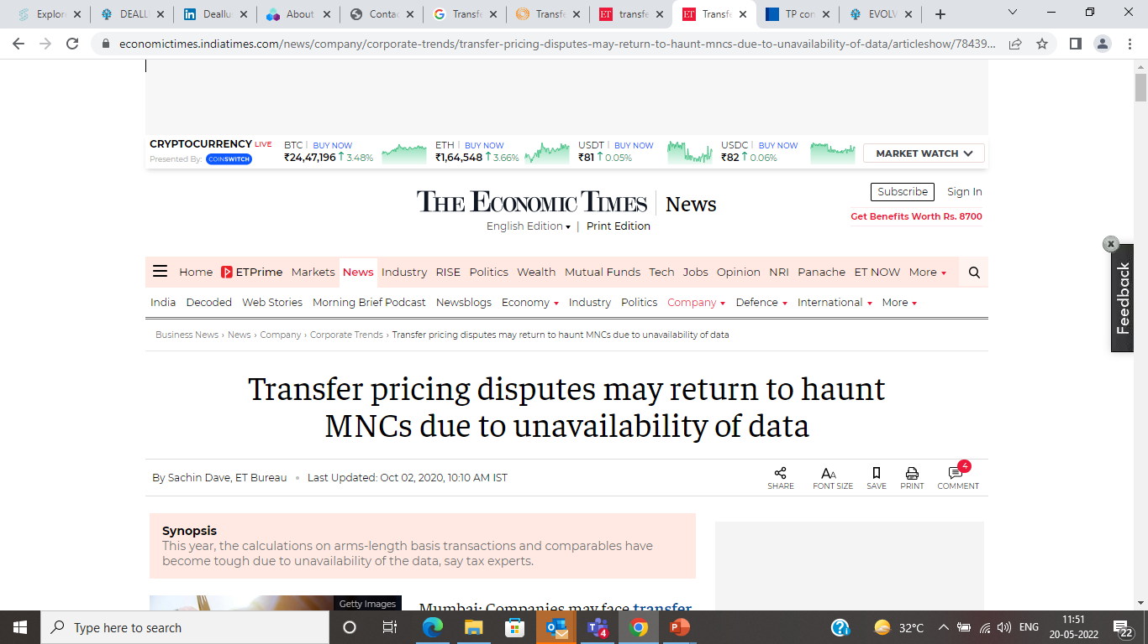
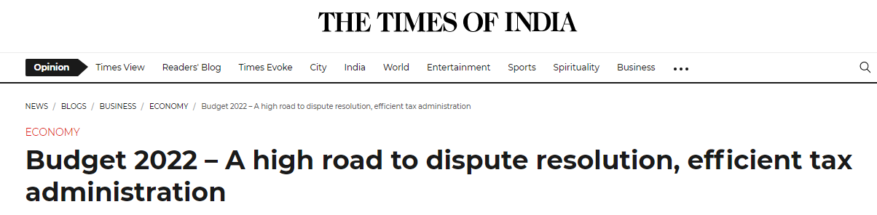
transfer pricing IN INDIA
AGGRESSIVE COUNTRY...

Slide 33



transfer pricing IN India
…AGGRESSIVE COUNTRY
India – one of the top countries with aggressive transfer pricing disputes
MNCs with related party transactions seen as one of the targets for tax collection
Focus on profit margins – location saving embedded in high comparable margins
Subjectivity on comparables selection – tax officer tries to select high-profit margin comparables
Functional re-characterization (adding new weapons such as surveys, information from 3rd parties, social media)
Rejection of economic adjustments
Triggers
Any pricing model change
Low profitability
Dip in related party revenue
Royalty payments
Subjectivity on comparables
Intra-group charges
Domestic litigation route
Need for Despite Resolution and Tax certainty
High Court
Supreme Court
Tax Tribunal
First level appeal
Field Officer
6 to 8 years
6 to 8 years

Slide 34

EMERGING TP ISSUES
KEY TRENDS
Management Cross Charges
Royalty
Litigative issue - generally prevalent in MNCs
Tax Authorities allege siphoning out of money
Extremely subjective – difficult to demonstrate receipt of services, actual benefits from services
Cost allocation strategy
Need-Benefit documentation is the key
Rationale for paying Royalty gets challenged
Royalty rate gets challenges – comparables related challenges
Claims for being ‘duplicative’ in nature
Important to demonstrate exclusivity, criticality for using brand/ technology/ etc, maintain proper workings
Comparability challenges
Functional characterisation
Choice of comparables has always been a subject matter of discussion
Broad comparability acceptable in law
Tax Authorities prefer high-profit margin comparables
Critical to use right quantitative filtration and qualitative review for comparable selection
Subjectivity around Transfer Pricing
Remuneration model gets challenged
Proper documentation of functional aspects is extremely critical
Remuneration to commensurate with functions and risk profile of Indian entity

Slide 35
INDIAN ADVANCE PRICING AGREEMENT (APA) PROGRAM

Slide 36
INDIAN APA PROGRAM
KEY FEATURES
Advance Pricing Agreement (APA)
An agreement between taxpayer and Indian government/ tax authority, in order to determine arm’s length price OR specifying the manner in which arm’s length is to be determined.
Types
Coverage
Binding Effect
Timelines
Unilateral: Involves taxpayer and India APA authority
Bilateral: Involves taxpayer, India APA authority, foreign entity, foreign APA authority
Multilateral: Involves taxpayer, India APA authority, multiple foreign entities, respective foreign authorities
APA covers 5 prospective years, starting after filing of APA application – also has an option to apply APA result up to past 4 years (roll back years).
APA, when agreed and signed, is binding on taxpayer and income tax authorities.
Binding in respect of international transactions covered in APA.
Average time taken in the process to get APA:
Around 2 years in case of Unilateral APA
Around 3 years in case of Bilateral or Multilateral APA
Preparation for APA filing and Pre-filing discussion
APA application filing
Discussions, Written submissions, Site visit, Position paper review, etc
Finalization and APA signing

Slide 37
APA ADVANTAGE
VALUE OF APA vs NO APA
Approach
Aggressive pricing approaches adopted during TP audits
Challenge in explaining functional characterization along with economic analysis
Paucity of time to understand the business and dispose cases
Batch processing approach for common issues – standard comparable applications for margins
Duration
Yearly audit – takes 6-8 years to defend through normal litigation route
Compliance
Lack of clear direction during TP audit proceedings
Significant additional information sought at the time of TP audit
Without APA
Approach
Consultation process and pragmatic approach
Able to devote necessary time
Each case is handled separately and only physical mode to discuss the business and transactions
Duration
About 2 years to get certainty for 9 years (with a good possibility of renewal thereafter)
Compliance
Clear agreement on the financial and other information to be maintained
With APA

Slide 38
INDIAN MUTUAL AGREEMENT PROCEDURE (MAP) REGIME

Slide 39





INDIAN MAP REGIME
Alternative mechanism for domestic litigation route
Resolution of disputes through intervention of Competent Authorities (CAs)
Avoidance of double taxation
Suspension of collection of demand
Appeal/ tax demand proceedings can be kept in abeyance till MAP conclusion

Slide 40
INDIAN MAP REGIME
MAP OVER DOMESTIC APPEAL PROCESS
Parameters | MAP process | Domestic appeal process
Estimated time of completion | Average time period of 2 years | 6-10 years
Documentation requirement | Less burdensome as compared to domestic litigation | Detailed and burdensome documentation/ evidence requirements
Payment of tax demand | Stay of demand can be obtained | Periodic tax demands can be raised by the tax authorities
Compliance | Minimum | Extensive
Interest and Penalty | Interest: same as in typical litigation process Penalty: generally not levied by authorities post MAP | Penalty – generally levied, however, defendable on TP issues
Double taxation | Addressed issue of double taxation – corresponding relief is allowed | Likely to continue
Basis of closure | Negotiation between two countries’ CAs. Taxpayer’s role is to brief the CA | Merit based – relief can be expected at Tribunal level once sufficient evidence is produced satisfying the arguments

Slide 41
THANK YOU

