Slide 1

RSV
Rajiv Singh
FCA, CISA(USA), Registered Valuer
Founder Director|| RS Valuation Services Private Limited
Former Director of Union Bank of India

Slide 2
RSV
An Insight into Early Stage Company (ESC) Valuation

Slide 3
Key Issues
No thought to how we know what we think we know
Micro –Macro problem
Most of the pricing decisions are made on autopilot mode
Some past patterns and assumptions are taken as non-debatable truths (NDT)
Short-termism is preferred while making a decision
Methods used for financing ESE do not meet professional valuation standards
Increasing growth is easy but doing it profitably is not
Intangibles are key for ESC – in technology-based ESC the bulk of the value is in the intangible investment opportunities
Preference for the valuation of ESC- the Jokey or the Horse or Both
Different market participants

Slide 4
Key Issues
Going concern qualification under audit has a different perspective and purpose as compared to valuation standards- auditors generally do not count the value of intangibles, or self-created assets for going concern qualification
Historical financial statements of the subject company may not be relevant in most cases
Probability of future funding
In the case of ESC valuation, solvency, and liquidation analysis should consider future prospects in addition to historical data
Few VCs use either DCF or any other standard finance techniques for assessing deals
Most VCs use cash-on-cash return ( cash returned from the investment to cash invested) or IRR of the deal
The discount rate is computed on mature listed companies ( “as if publicly traded”) which bear less risk than a new venture that will most probably fail even before breaking even is inappropriate for the valuation of ESCs

Slide 5
Key Issues
Typically post-money valuation is calculated by the price paid in a given external financing round and multiplying it with the total number of shares outstanding -is it Right?
VC-backed firms issue different classes of stock and these classes can have substantially different values depending upon how are they structured and their rights and preferences
Assuming all shares worth as much as those issued in the latest external round would substantially overvalue the company because investors typically receive convertible preferred shares and the founders and employees receive common shares or options on common shares.
The Gornall- Strebulaev method helps in estimating value of such companies

Slide 6
Key Issues
Founders’ Influence on Valuation
“We live and die by our founders” (the legendary VC investor Peter Thiel ) Founders’
Factors | Percentage of VC Firms
Founders | 95%
Business Model | 74%
Market | 68%
Industry | 31%
Company Valuation was the fifth cited factor in the decision about which deal to pursue
Source: Harvard Business Review

Slide 7
Key Issues
Founders’ Influence on Valuation
The valuation of a startup company is positively influenced by:
Having more than one founder,
Having a complete management team,
Previous startup experience, management, and relevant industry experience, and
also a higher level of education Köhn (2018)
“Successful previous founding experience are both more likely to receive VC funding through a direct tie and to have higher VC valuations”. D.H. Hsu (2007)

Slide 8
Key Issues
Influence of Innovation on Valuation
Companies with a high degree of intellectual capital (IC) tended to outperform non-IC-intensive firms after the global financial crisis. Nemlioglu and Mallick (2020)
IC-intensive firms also seem to have higher market valuations in general, with lower uncertainty in those valuations, irrespective of their debt structure during economically bad times. Nemlioglu and Mallick (2020)
High R&D activity, patents, advertising intensity, and debt tend to increase the market valuation.
R&D and patents reduce valuation uncertainty

Slide 9
Key Issues
Influence of Governmental and social Factors on Valuation
The more VCs are protected the lower the uncertainty of investors, creating the basis for “high early-stage start-up valuations” and vice versa.
Startups based in innovation-friendly countries are generally assigned a higher valuation.
Young companies with an entrepreneurial and innovative approach are assigned higher valuations
ESC having business models that depend on government contracts have lower risk and therefore a lower cost of equity, high working capital, and low growth potential except few

Slide 10
Understanding Operational Dynamics of ESC
How fast will the business grow: Revenue Growth
How profitable will it be: ROIC minus WACC
How long it sustain profitable growth: Economic moat
Revenue Building vs. Profit Building
Good Business vs. Story Business
Is ESC focused on building great products/services, marketing, or both?
Gornall and Strebulaev (2020) analyze the valuations of 135 “unicorn financings” and document that the reported post-money valuations are nearly 50% above fair market value when analyzed using a contingent claims valuation framework.

Slide 11
Key Issues
High Growth Potential –Key Value Driver
On November 7, 2013, Twitter was IPOed at a price of USD 26 per share, valuing it at $12.8 billion (20 times its turnover)
On the first day of trading, the stock price increased by a staggering 73% to USD 45, implying a valuation of USD 30 billion (60 times its turnover)- this means investors were buying a share for 60 years of Twitter’s turnover
Twitter incurred a USD130 million loss for the fiscal year 2013, and even the management did not believe it would be profitable before 2015.
Twitter revealed a 100% growth rate of its turnover in one quarter only during that time
Reason for the high price: Growth

Slide 12
Key Issues
High Growth Potential –Key Value Driver
Characteristics of a typical ESC
High growth potential
Very limited financial history,
Many financial indicators such as EBITDA or Net income are negative or very small,
Risk of failure is high - In 100 new ventures, only 16% survive the first ten years
High risk of patent infringement
Size- ESC size is defined in terms of equity value like Unicorns
Complex capital structure – multiple classes and series of shares with different rights and privileges
Governance
Availability and quality of financial information

Slide 13
Understanding Operational Dynamics of ESC
Noise Trumps Knowledge and Skews Valuation

Slide 14
Understanding Operational Dynamics of ESC
Unrealistic Expectations Lead to Self-fulfilling Prophecy

Slide 15
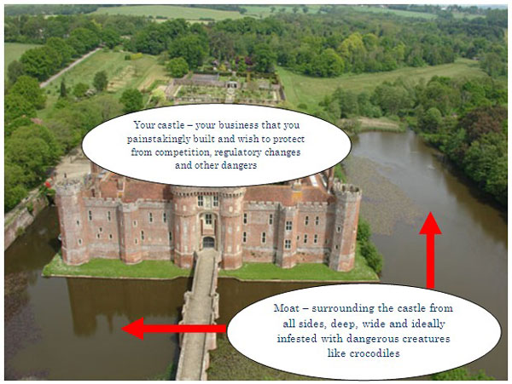
Understanding Operational Dynamics of ESC
Economic Moat – Wider or Narrower has a significant impact on Valuation

Slide 16
Valuation Method of ESC
Stages of ESC | Indicators | Valuation Methods
Seed Stage/ Angel Stage | Commercial operations are being established No products and revenue Little expense history | The Payne Scorecard Method The Risk Factor Summation (RFS) Method Berkus Method 1.0 Enhanced Berkus Method Venture Capital Method The First Chicago Method( FCM)
Early VC Stage | ESC has started operating Building up its management team Opex is higher than revenue Losses are driven by R&D, marketing and advertisement expenses Early rounds of series A and B financing | Income Approach- DCF and Real Option Market Approach- GPCM, GTM, and Backsolve Method Cost Approach-Adjusted Net Asset Value
Late VC Stage | High Revenue growth May have substantial revenue but continue to generate losses Negative CFO | Income Approach- DCF and Real Option Market Approach- GPCM, GTM, and Backsolve Method Cost Approach-Adjusted Net Asset Value

Slide 17
Valuation Method ESC
The Payne Scorecard Method

Slide 18
Valuation Method ESC
The Payne Scorecard Method

Slide 19
Valuation Method ESC
The RFS Method

Slide 20
Valuation Method ESC
The RFS Method

Slide 21
Valuation Method ESC
The Berkus Method

Slide 22
Valuation Method ESC
The VC Method with Dilution
Step I: Estimate time to Exit (T): Estimated by the Investor
Step II Estimate the value at the Exit -Use market multiples, DCF, or average of successful exit in the same industry
( Assume 20 m revenue and an exit of 6x)
Step III: Estimate the Discount Rate
Assume a 60% probability of failure and investor required return of 25% over 7 years
Step IV: Estimate the retention Percentage ( estimated by an investor based on its experience; say 30%)
The VC method requires estimates of revenue at exit, probability of failure for the company, and dilution, all of which can be subject to considerable uncertainty.
The model has features of the market and income approaches, both of which have significant limitations when they are applied to seed-stage enterprises

Slide 23
Valuation Method ESC
The FCM
The FCM uses a scenario-based approach that looks at the performance of an ESC under three scenarios:
Scenario 1 (Success): ESC achieves exceptional business performance within or above financial projections.
Scenario 2 (Survival ): ESC underperforms the success scenario due to delays in product approval or business pivots, resulting in higher expenses or longer time to market.
Scenario 3 ( Failure): ESC underperforms the survival scenario and sees a continuation or a deterioration of the business resulting in capital losses or business failure.

Slide 24
Valuation Method ESC
The FCM

Slide 25
Key Issues
The Backsolve Method
This method provides a basis also for subsequent measurements of the company’s equity value, as the model built at the time of the initial transaction is “calibrated” to reflect changes in market conditions that affect the model’s key inputs and
assumptions over time.
The validity of this method relies heavily on the quality of the transaction price (arm’s length price) that is used as a basis for valuation
The AICPA PE/VC Valuation Guide defines the Backsolve method as “a method within the market approach wherein the equity value for a privately held company is derived from a recent transaction in the company’s own instruments.[ . . . ]

Slide 26
Key Issues
DCF –Key Issues for the Valuation of ESC
Every founder presents their PFI as reasonable- is it so in reality?
Have come across circumstances where promoters say that the FPI presented by them represents the deepest and most profound fantasies they’ve ever had?
Evaluate biases in the PFI- Nudge the PFI
Estimate discount rate after considering appropriate discount rate – Use total beta instead of beta depending upon the facts of the case

Slide 27
Biases – How to Nudge?
(a) Forecast Biases vs. Forecast errors
Forecast error is the uncertainty inherent in the PFI
Forecast bias occurs when forecasts are overly optimistic or overly pessimistic due to the motivation of the Preparer.

Slide 28
Nudging Forecast bias is possible either through Cash Flow or discount rate but avoiding double counts
Scrub unrealistic assumptions
Create Scenarios
Adequate Adjustment in discount rate

Slide 29
Biases – How to Nudge?
Traditional Finance: In the long run most firms can be expected to earn their cost of capital. In exception cases long-run competitive advantages are possible.
Terminal value bias: PVGO > O [ROIC > WACC]
Zero PVGO is the rule rather than the exception

Slide 30
Biases – How to Nudge?
(a) Representativeness Heuristic Biases:
In-built feature of the brain for producing rapid probability judgements rather than consciously adopted procedures
New information is classified based on past experience
Sample size neglect
Occurs when the similarity of objects or events confuses people's thinking regarding the probability of an outcome.
People frequently make the mistake of believing that two similar things or events are more closely correlated than they actually are

Slide 31
Biases – How to Nudge?
(b) Confirmation bias:
People tend to look for and notice what confirms their beliefs
(c) Availability bias
People recall the salient events – that is those that are very recent and/or those they are or were emotionally involved
Affects estimation risk
Prevents from considering other potential and and relevant outcomes

Slide 32
Biases – How to Nudge?
(d) Anchoring and Adjustments
Different starting points yield different estimates which are biased towards the initial value
Information that is visibly irrelevant still anchors judgements and contaminates guesses
Locate Confidence in judgements based on overconfidence (unwarranted faith in own intuitive reasoning, judgement and/or cognitive ability
Hindsight bias

Slide 33
Biases – How to Nudge?
(e) Conservation bias:
People maintain their prior views or Forecasts by inadequately incorporating new information.
Lack of capacity to incorporate new information.
(f) Status quo bias:
An emotional bias in which people do not want to change.

Slide 34
Biases – How to Nudge?
(g) Endowment bias:
An emotional bias that causes individuals to value an owned object higher, often irrationally, than its market value
(h) The halo effect:
The tendency to like or dislike everything about a subject.

Slide 35
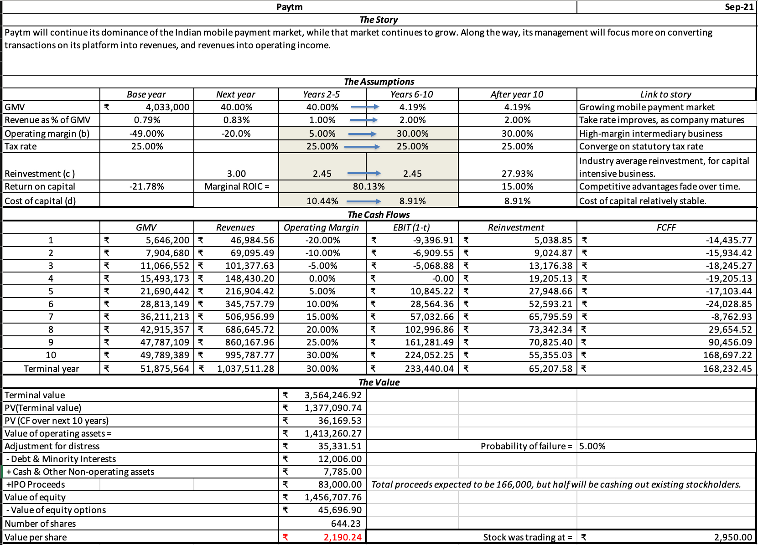
Paytm valuation by Damodaran

Slide 36
Paytm

Slide 37
Paytm

Slide 38
Paytm

Slide 39
Paytm

Slide 40
Paytm

Slide 41
Paytm

Slide 42
Paytm

