Slide 1
CPA- Corporate Presentation

Slide 2
Opportunities for Professional Accountants
Changes in technology, accounting standards and regulatory environment
Shortage in Skilled Accountants (Acquisition & Retention)
Employment for accountants and auditors is expected to grow by 10% between 2016 and 2026, faster than average
  Outlook is best with College degree and Professional Certification, especially a CPA *
AICPA and IMA estimates that approximately 75% of its members will be eligible to retire by 2021**
* https://www.bls.gov/ooh/business-and-financial/accountants-and-auditors.htm
** https://www.aicpa.org/advocacy/state/retiredcpastatusexposuredraft.html
Notes:
Even in a weak job market, the demand for accountants, and CPAs in particular, remains healthy.
Research conducted by the U.S. Bureau of Labor Statistics projects that employment of accountants and auditors to expected to grow by 16% through 2020, faster than for any other occupation. The report goes on to state that the outlook is best for those “who have a college degree and professional certification, especially a CPA.”
What’s more, as the boomers move toward retirement, the gap between available positions and qualified individuals is expected to grow, In fact, according to the AICPA, 75 percent of today’s CPAs will retire over the next 15 years.
Salary increase between 4-5.5% for 2016 across all levels, based on Robert Half 2016 salary guide
Changes in technology & regulatory environment
Cloud computing and integrated information system
Regulation changes, especially in financial services
Being in a profession that is in demand puts you in the driver’s seat. With more demand, comes more flexibility, greater job security and increased opportunity.

Slide 3
Benefits & Opportunities
Global recognition & diverse opportunities
Relatively short time to complete
Reciprocity between AICPA/NASBA and other accounting professional bodies (e.g. CPA Canada, CA Australia & New Zealand, ICA Scotland, Hong Kong Institute of CPA….)
Notes:
IMA Global Salary Survey 2019:
CMA earns 55% more in median compensation than non-CMA
CMA between the age of 20-29 earns 70% more in total compensation than non-CMA
CPA salary in USA (Journal of Accountancy)
Average US$116k + bonus about 10%
< 1 year experience: $66k
>20 year experience: $152K
Expected increase 5%
Average CA salary in India: INR7.26 lakh per year (payscale.com)

Slide 4
Key Organizations
AICPA
The American Institute of Certified Public Accountants is the professional organization for CPAs in the US.
State Boards
NASBA
Responsible for the delivery of the Exam to approved test centers, scheduling candidate test appointments, test administration, and the return of results to the AICPA for scoring.
Prometric
Responsible for the development and scoring of a valid, legally defensible examination.
The Exam functions as a tool that helps the state boards fulfill their regulatory responsibilities.
The State Boards regulate the accounting profession and serve as the licensing body for CPAs.
The National Association of State Boards of Accountancy is an association of the state boards.
Helps the state boards coordinate their activities and maintains the National Candidate Database
Provides a forum for regulators and practitioners to address issues relevant to the profession.

Slide 5
Education Requirements
Vary among different States & U.S. Jurisdictions
General rule
  150 credit hours (5 year college education), within which 24 accounting and 24 business credits
  Bachelor degree or higher
A few States still allows 120 or less credit hours to sit (e.g. Guam, New Hampshire, Montana)
Notes:
Montana, Guam, Colarado (currently in a degree program with 150 credits to graduate)

Slide 6
Then How?
Notes:
So, how do you obtain your CPA License?

Slide 7
Uniform CPA Exam
Computer Based, On Demand Exam
Majority Objective Based Questions (MCQ and TBS)
4 x 4 hours
75% to pass
Notes:
So, how do you obtain your CPA License?

Slide 8
Steps to Becoming a US CPA
Meet the Education Requirements
Apply for the Exam with State Board
Schedule exam with Prometric
Pass Exam Apply for CPA License
Foreign Academic Evaluation (NIES or others)
Authorization to Test (ATT), Notice to Schedule (NTS)
Travel arrangement, U.S. Visa, if needed
Work experience, Add’l education requirements, if needed
Prepare with Simandhar

Slide 9
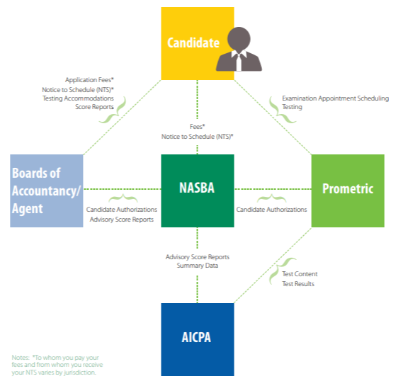

Slide 10
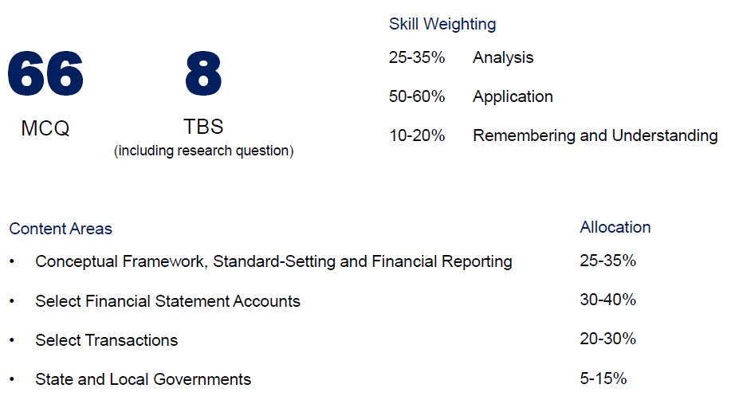
Far financial accounting & reporting
Notes:
Now let’s take a look at the content covered on each section of the Exam.
The financial section covers generally accepted accounting principles for business enterprises, governmental entities and not-for-profit organizations.
From an international perspective, you will be expected to answer questions on International Financial Reporting Standards (IFRS) and understand the difference the financial statements prepared on the basis of U.S. GAAP and IFRS.
Your Intermediate Accounting classes will serve as the foundation for this exam. If you have taken Advanced Accounting and/or an elective course in Government/Not-for-Profit Accounting all the better. If you haven’t taken these additional classes, no need to worry. Our course covers what you need to know in these areas.

Slide 11
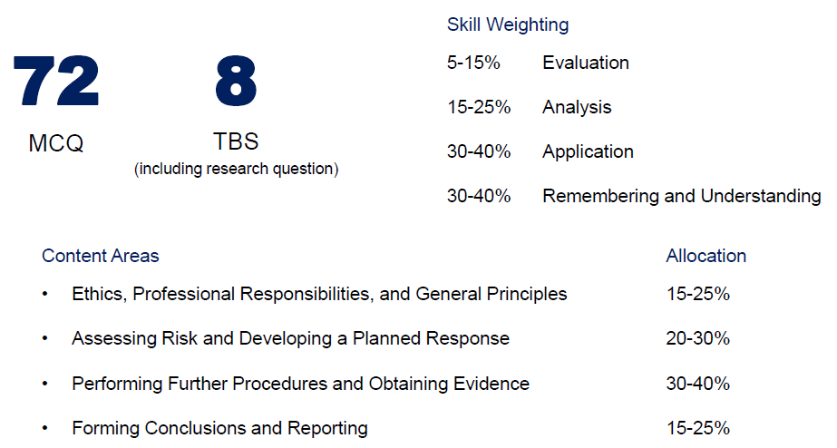
AUD auditing and attestation
Notes:
Now let’s take a look at the content covered on each section of the Exam.
The financial section covers generally accepted accounting principles for business enterprises, governmental entities and not-for-profit organizations.
From an international perspective, you will be expected to answer questions on International Financial Reporting Standards (IFRS) and understand the difference the financial statements prepared on the basis of U.S. GAAP and IFRS.
Your Intermediate Accounting classes will serve as the foundation for this exam. If you have taken Advanced Accounting and/or an elective course in Government/Not-for-Profit Accounting all the better. If you haven’t taken these additional classes, no need to worry. Our course covers what you need to know in these areas.

Slide 12
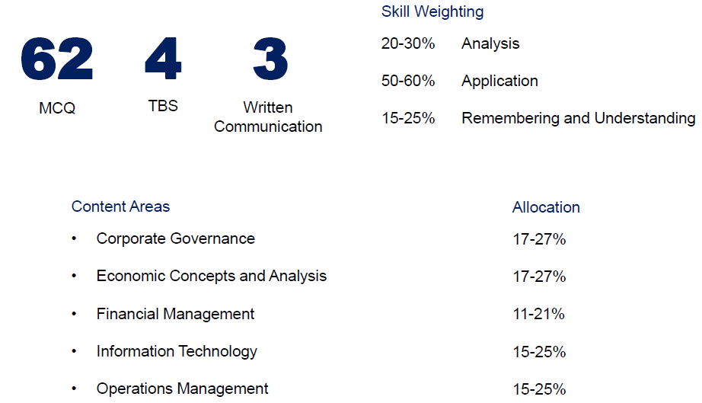
BEC business environment & concepts
Notes:
Now let’s take a look at the content covered on each section of the Exam.
The financial section covers generally accepted accounting principles for business enterprises, governmental entities and not-for-profit organizations.
From an international perspective, you will be expected to answer questions on International Financial Reporting Standards (IFRS) and understand the difference the financial statements prepared on the basis of U.S. GAAP and IFRS.
Your Intermediate Accounting classes will serve as the foundation for this exam. If you have taken Advanced Accounting and/or an elective course in Government/Not-for-Profit Accounting all the better. If you haven’t taken these additional classes, no need to worry. Our course covers what you need to know in these areas.

Slide 13
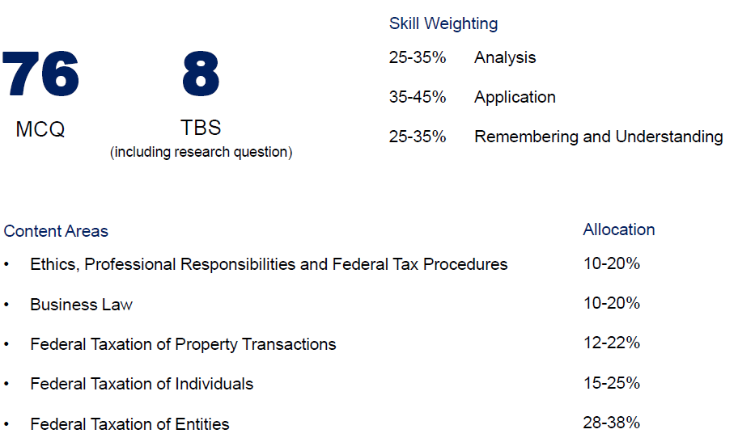
Reg regulation
Notes:
On the Regulation exam, as much as 60% of the Exam content is Federal Tax. The remaining 40% encompasses Business Law and Ethics.
With a focus on U.S. tax law and business law, the Regulation exam is effectively immune to IFRS.
The good news is that what you learn in two semesters of Federal Taxation and one to two semesters of Business Law will provide a solid foundation to build on for success on the Regulation Exam.

Slide 14
Exam Timeline
Apply
NTS: Typically 6 months
Upon passing the 1st section => 18 months to complete the remaining 3 sections
Start studying before you receive your NTS
You may not repeat a part in the same testing window
Before passing all 4 exams, each exam score expires in 18 months
Testing window covers 1st day of the quarter to the 10th day of the last month of the quarter
Notes:
Apply to NASBA or your state board allowing 2-4 weeks for them to process and approve your application. Applications aren’t reviewed until all documents have been submitted. The reviewer won’t contact you if something is missing. Many states have a checklist to help you file properly.
You will receive a Notice to Schedule (NTS). For most states, an NTS will be valid for 6 months. Apply and pay exam fees for only those parts that you can realistically sit for in that period.
Once your application has been approved you will be given the go ahead to pay your examination fee in order to receive your Notice to Schedule (NTS). The NTS allows you to schedule your exam at a Prometric site. Many NTSs expire in 6 months, so only pay for the sections you plan to take during that window.
If your state requires you to pay the application and examination fee at the same time, start preparing while waiting for your application to be approved.
If you find that you didn’t pass a section, you cannot re-take it during the same testing window. If it is early in the testing window, consider reviewing and taking another exam section. If it is late in the testing window, it may be better to re-study the section you didn’t pass and retake it as soon as possible in the next testing window.
Your 18 month time window starts the day you took the first section that you ultimately passed—not the day you found out you passed. Stay on track with your study plan to ensure you don’t lose a section. If you do lose a section, your 18 month window will now begin on the date you took your next passed section. But you will have to re-take the section you lost.
4 months of the year are non-testing months, and they do count in determining the 18 month timeline.

Slide 15
Why Becker& Simandhar?
Notes:
Why is it important to go the extra step and obtain your CPA license?

Slide 16

Why Becker & Simandhar?
  Comprehensive exam focused and efficient study and coaching system
  Since 2005, over 90% of all Watt Sells Award winners have prepared with Becker US
  More than 2,000 organizations trust Becker—including the Big 4 and all the top 100 accounting firms
  Only Institute who is providing live classes in India for CPA and CMA USA aspirants
Notes:
16
16
16
16
16
.
16

Slide 17
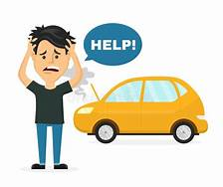
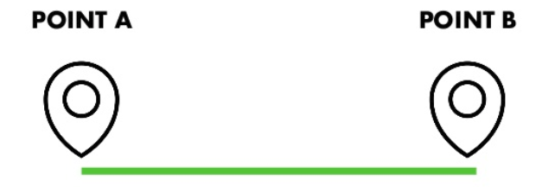
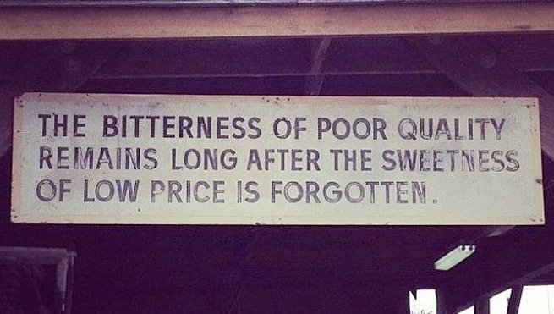
Make a Right Choice

Slide 18

Work with the Best
Simandhar Education
The most trusted name in
CPA and CMA exam review

Slide 19
For Additional Questions
https://simandhareducation.com
Notes:
Note to FMS: Provide your contact information and local website/Facebook information if applicable.
Draw a raffle winner if holding raffle.

